Slide 1
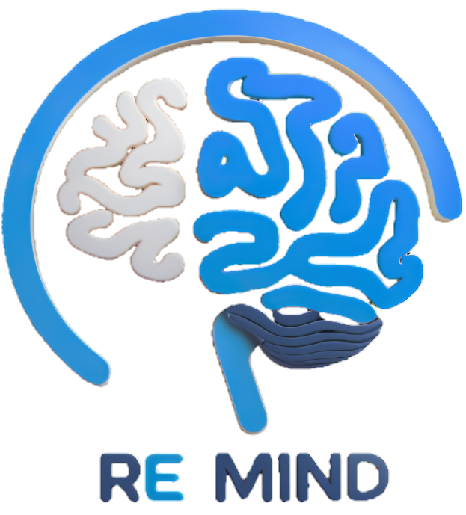
ReMind
Under Supervision of:
Dr. Shaimaa Galal
Eng. Aliaa
Mid-Year Discussion
Academic Year 2024/205
1

Slide 2
Team Members
Name | ID
Aya Mohamed Abdelrahman | 20211020
Karin Khair Abdallah Mataa | 20210292
Shimaa Amer Mohamed | 20211056
Mahmoud Sayed Abdel’aty | 20210370
Mario Malak Alabd | 20210313
Mahmoud Ali Abdelmnam | 20210371
2

Slide 3
Table of contents
01
02
03
04
05
06
Motivation
Problem Definition
Objective
Solution
Scope & Limitation
Related Work
07
08
09
ML & Location
Prototype
Technologies
3

Slide 4
02
03
04
01
05
06
Motivation
07
08
4
09

Slide 5
Motivation
02
01
03
Alzheimer's impairs memory, challenging patients and caregivers.
Traditional care is inefficient, requiring constant supervision.
Technology boosts patient independence and reduces caregiver strain.
Emergencies can occur unexpectedly in our interconnected world.
ReMind integrates AI, tracking, and reminders for better support.
04
05
06
07
08
5
09

Slide 6
02
Problem Definition
01
03
04
05
06
07
08
6
09

Slide 7
Problem Definition
02
02
03
Memory-related challenges impact daily life, especially for individuals with cognitive impairments.
Forgetting important tasks, medications, or appointments can lead to serious consequences.
Existing reminder systems lack personalization and adaptability to individual needs.
Staying with a caregiver in same place all time isn’t an efficient solution.
The current landscape lacks a smart, user-friendly, and unified solution for effective memory assistance.
04
05
06
07
08
7
09

Slide 8
03
Objective
01
02
04
05
06
07
08
8
09

Slide 9

Objective
01
03
02
Our project aims to tackle these issues by:
Developing smart and adaptive reminder solutions.
Creating a comprehensive platform that supports individuals with memory challenges.
Helping users manage daily tasks, medications, and appointments efficiently.
Providing remote monitoring and assistance without requiring constant physical presence.
Track and monitor people you care about.
By Addressing these concerns, we strive to make our world safer and healthier place for everyone.
04
05
06
07
08
9
09

Slide 10
04
Solution
01
02
03
05
06
07
08
10
09

Slide 11

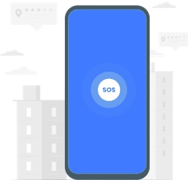

Solution
04
Community Support &
Educational Resources
SOS Request
Safe Zone & Boundary Alerts
Caregivers can access a support network, share experiences, and find expert guidance. Educational resources provide insights on managing Alzheimer’s, improving care, and enhancing daily life.
Patients can trigger an SOS request in case of an emergency. The system will instantly notify registered caregivers, allowing them to respond quickly and provide the necessary assistance.
The caregiver can define a geographical safe zone. If the patient wanders outside this area, an immediate alert is sent to caregivers, helping prevent disorientation or dangerous situations.
11

Slide 12


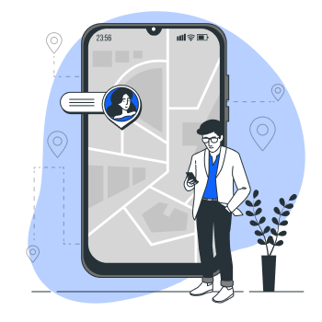
04
Solution Cont.
Medical Reminders
Real time location
Important Dates Reminder
Automated alerts help patients take their medications on time, preventing missed doses. Caregivers get notified if a reminder is skipped.
Caregivers can track the patient’s location in real time. Alerts are sent if the patient wanders into unsafe areas.
Patients receive reminders for medical appointments, birthdays, and important events, helping them stay connected and organized.
12

Slide 13

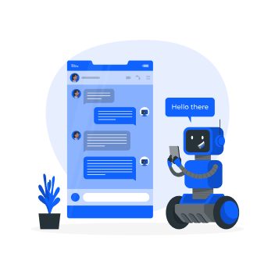
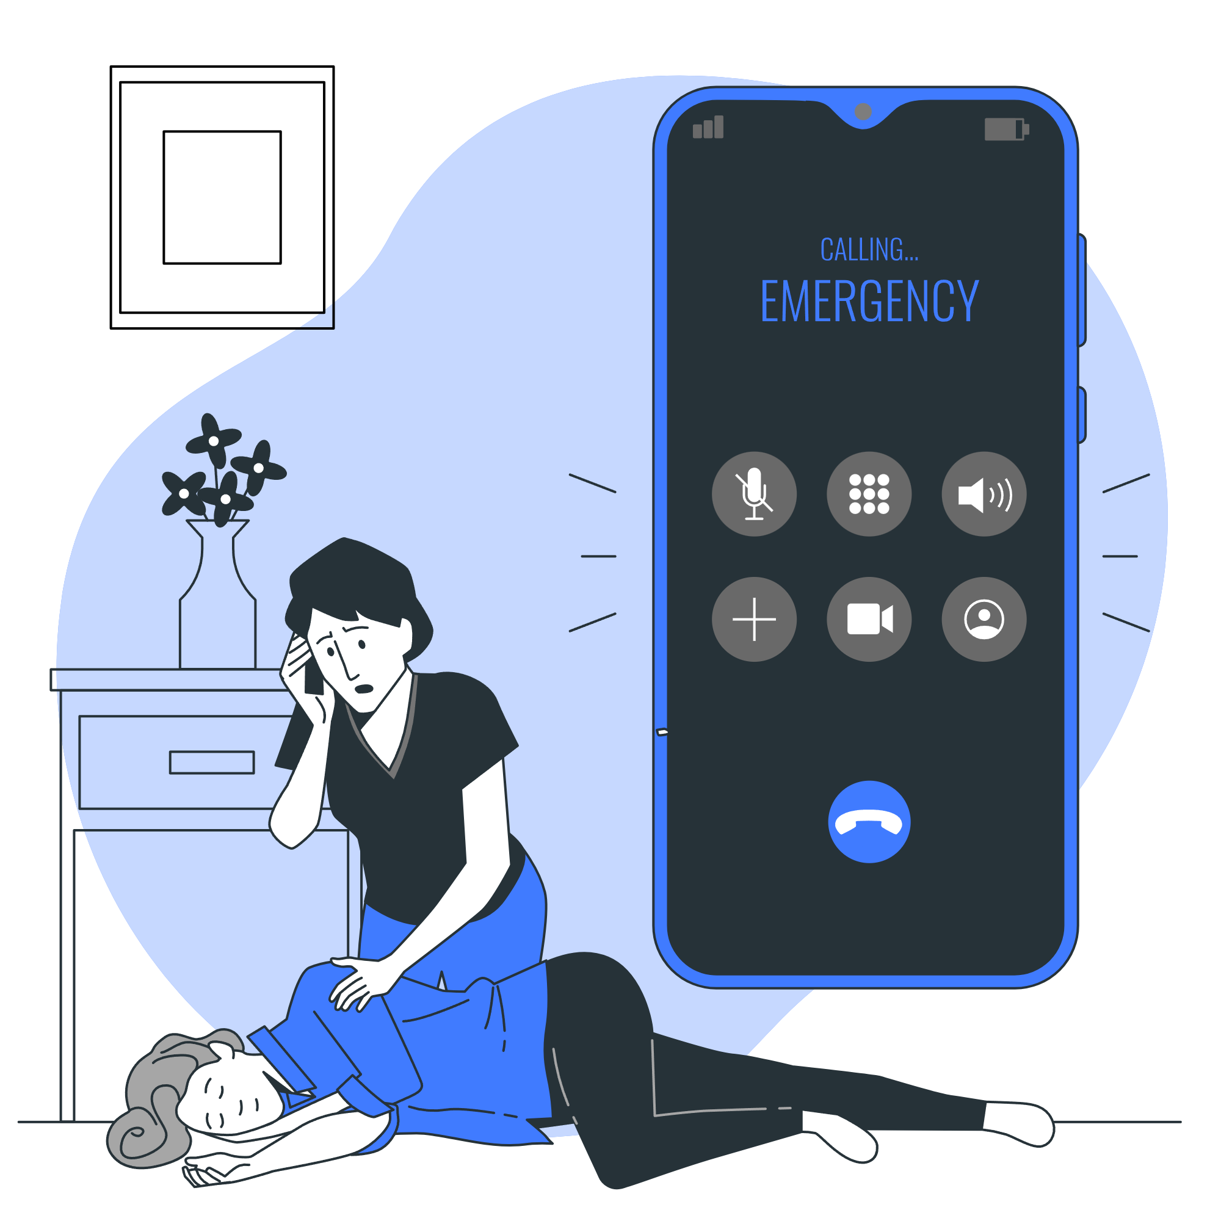
01
04
Solution Cont.
02
03
05
Memory Games
AI Chat bot &
Face Recognition
Emergency Contacts
06
The AI chatbot assists caregivers with guidance, and quick answers to common concerns. Face recognition helps patients identify family members and caregivers, reducing confusion and enhancing social interactions.
A quick-access list of emergency contacts allows patients or caregivers to call for help instantly when needed.
Engaging memory games help stimulate cognitive function and slow decline, while also tracking the patient’s progress over time.
07
08
13
09

Slide 14
05
Scope & Limitation
01
02
03
04
06
07
08
14
09

Slide 15
05
Scope
The project scope specify the functionality of each user in our app:-
Patient:
Receive medication reminders
Access memory training exercises
Use face recognition to identify people
Trigger emergency actions to alert caregivers.
Caregiver:
Monitor the patient’s real-time location.
Set medical and appointments reminders.
Control safe zones for the patient
Interact with a chatbot to receive caregiving tips, support.
Admin:
Add educational resources to the community.
Monitor overall system usage.
Send announcements and updates for the users
15

Slide 16
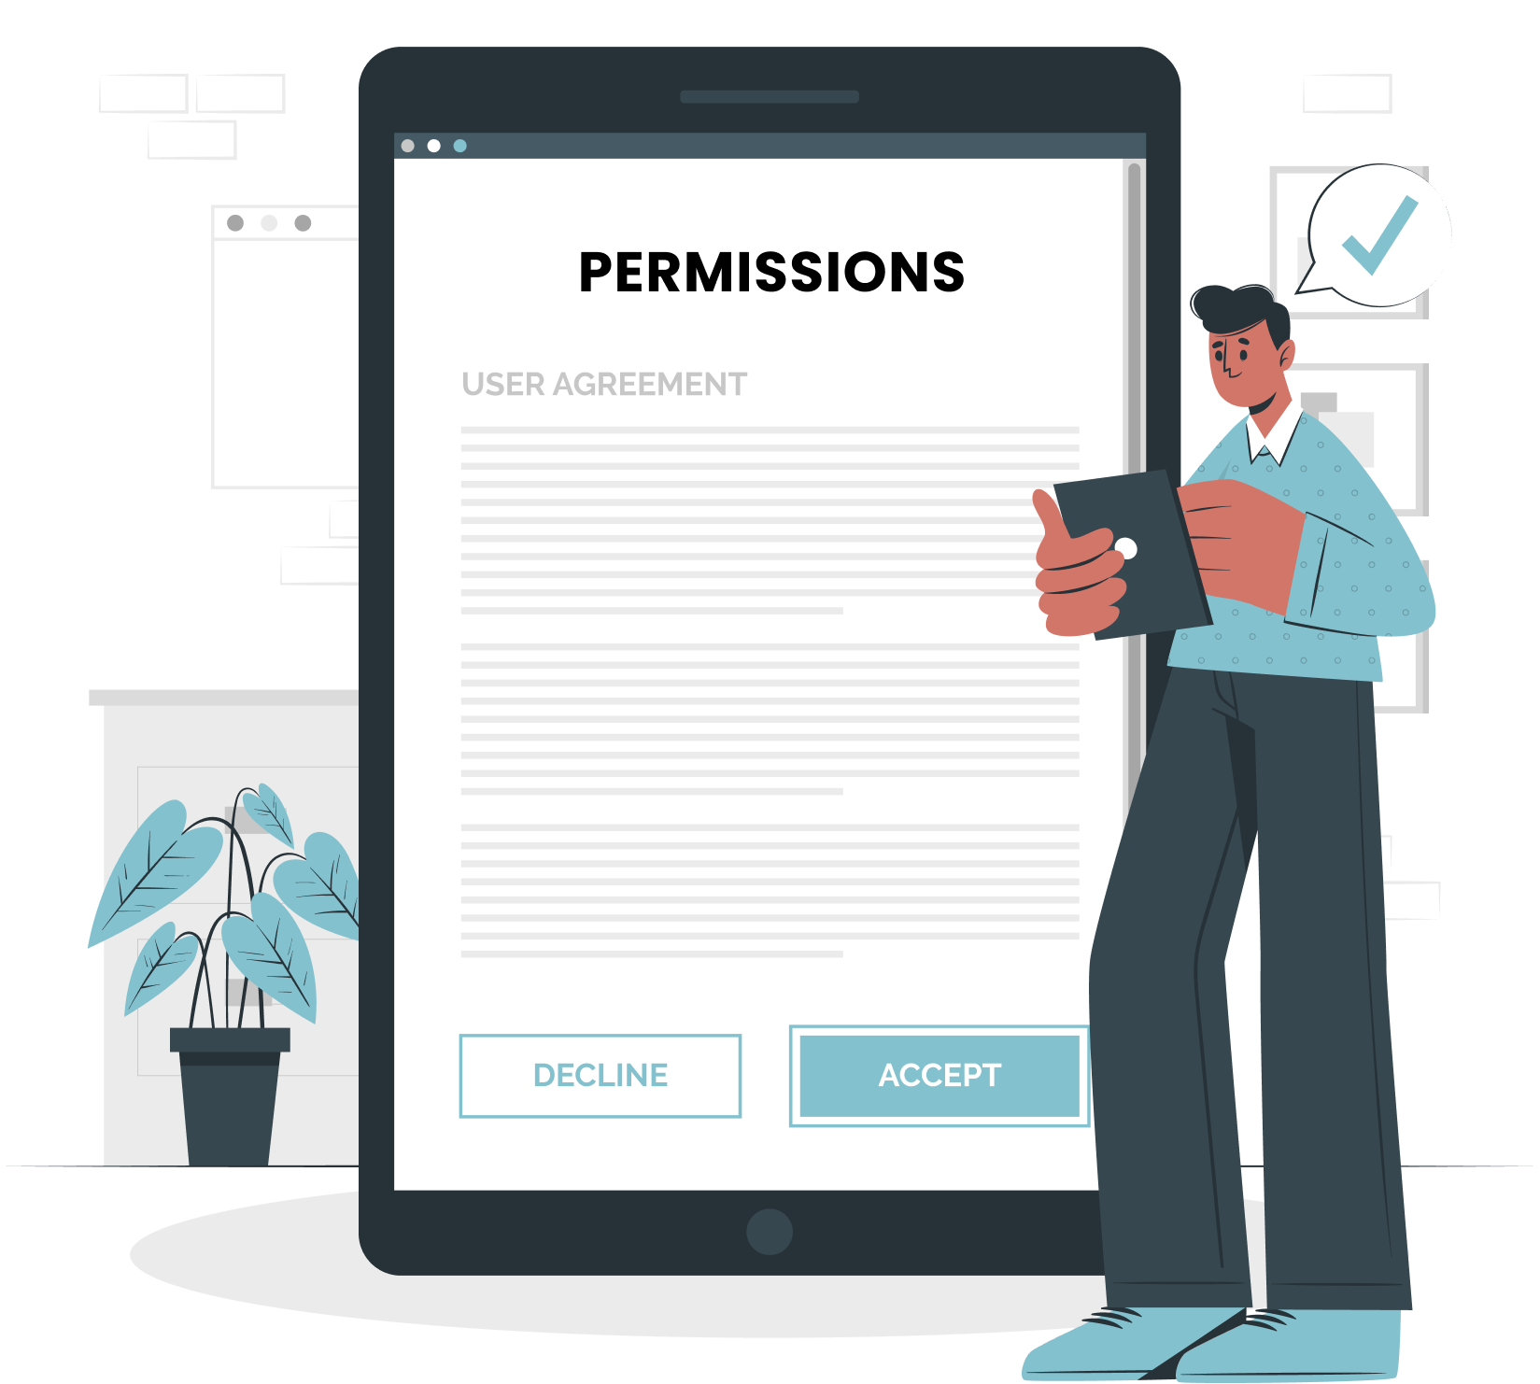
01
05
Limitations
02
Location Tracking: Requires user permission and a stable internet connection. Accuracy depends on device, network, and GPS quality.
Health Catalog: May not cover all health conditions.
Patient Responsibility: Must confirm medication intake and stay connected to the internet for tracking and alerts.
Caregiver Responsibility: Must set safe zones, respond to SOS alerts, and ensure a stable internet connection for real-time notifications
03
04
06
07
08
16
09

Slide 17
06
Related Work
01
02
03
04
05
07
08
17
09

Slide 18
06
Related Work
Feature | ReMind | alzbetter | Rafiq Al-zakira | Care Partner | Life360 | Alzheimer’s App | CaringBridge | Alz connecd
Forum for sharing personal experiences | ✔ | _ | _ | _ | _ | _ | _ | ✔
Reminders for medication | ✔ | _ | ✔ | ✔ | ✔ | _ | _ | _
Journal entries for tracking care | ✔ | _ | _ | ✔ | _ | _ | ✔ | _
Community support | ✔ | ✔ | _ | _ | _ | _ | ✔ | ✔
18

Slide 19
01
06
Related Work Cont.
02
03
Feature | ReMind | alzbetter | Rafiq Al-zakira | Care Partner | Life360 | Alzheimer’s App | CaringBridge | Alz connecd
Forum for sharing personal experiences | ✔ | _ | _ | _ | _ | _ | _ | ✔
Reminders for medication | ✔ | _ | ✔ | ✔ | ✔ | _ | _ | _
Journal entries for tracking care | ✔ | _ | _ | ✔ | _ | _ | ✔ | _
Community support | ✔ | ✔ | _ | _ | _ | _ | ✔ | ✔
04
05
07
08
19
09

Slide 20
07
ML & Location
01
02
03
04
05
06
08
20
09

Slide 21
07
Machine Learning
Our feature: Face recognition
Used Algorithm: Convolution neural network (CNN)
Dataset: Consisting of general and custom photos for each patient.
Visualization: Details about the recognized person.
Benefits:
Real-Time Updates.
Personalized Assistance
Accurate Identification.
21

Slide 22
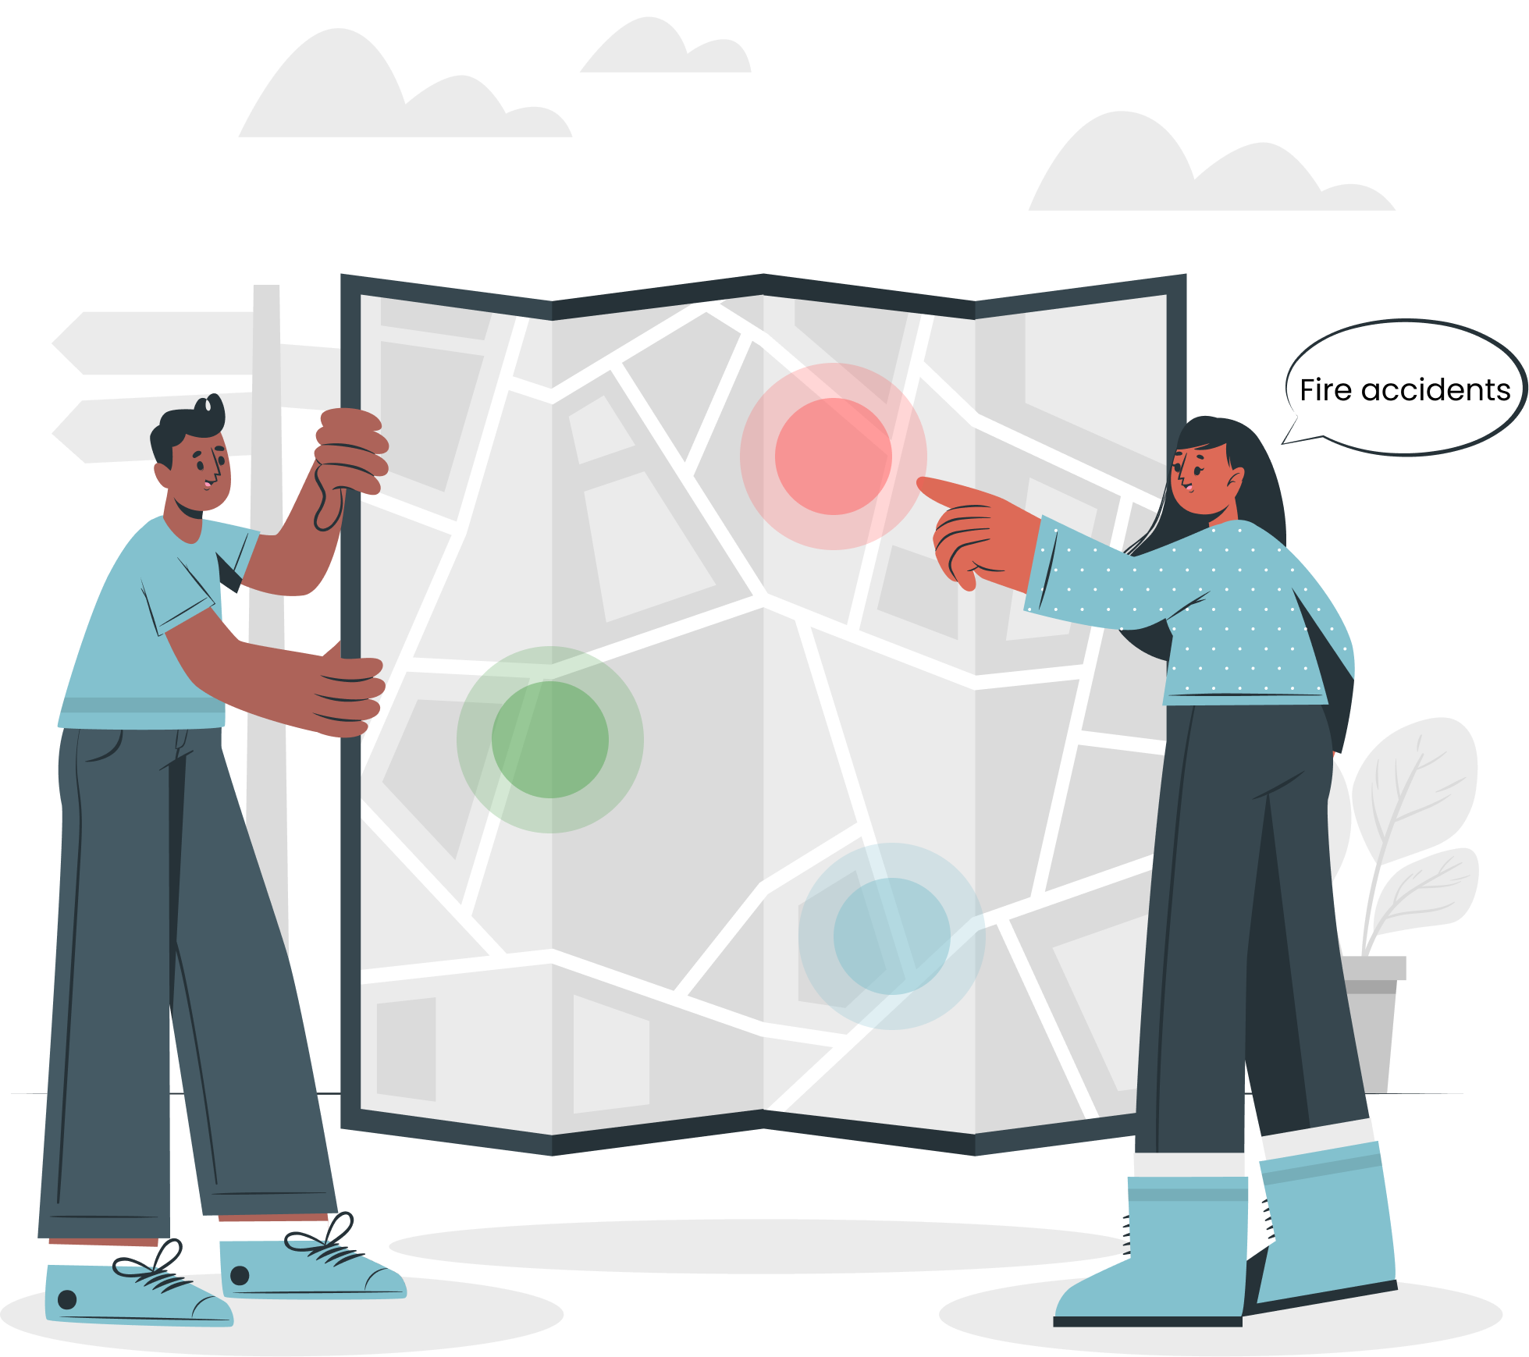
07
Location System
01
02
Our feature: Face recognition
Used Algorithm: Convolution neural network (CNN)
Dataset: Consisting of general and custom photos for each patient.
Visualization: Details about the recognized person.
Benefits:
Real-Time Updates.
Personalized Assistance
Accurate Identification.
03
04
05
06
08
22
09

Slide 23
08
Prototype
01
02
03
04
05
06
07
23
09

Slide 24
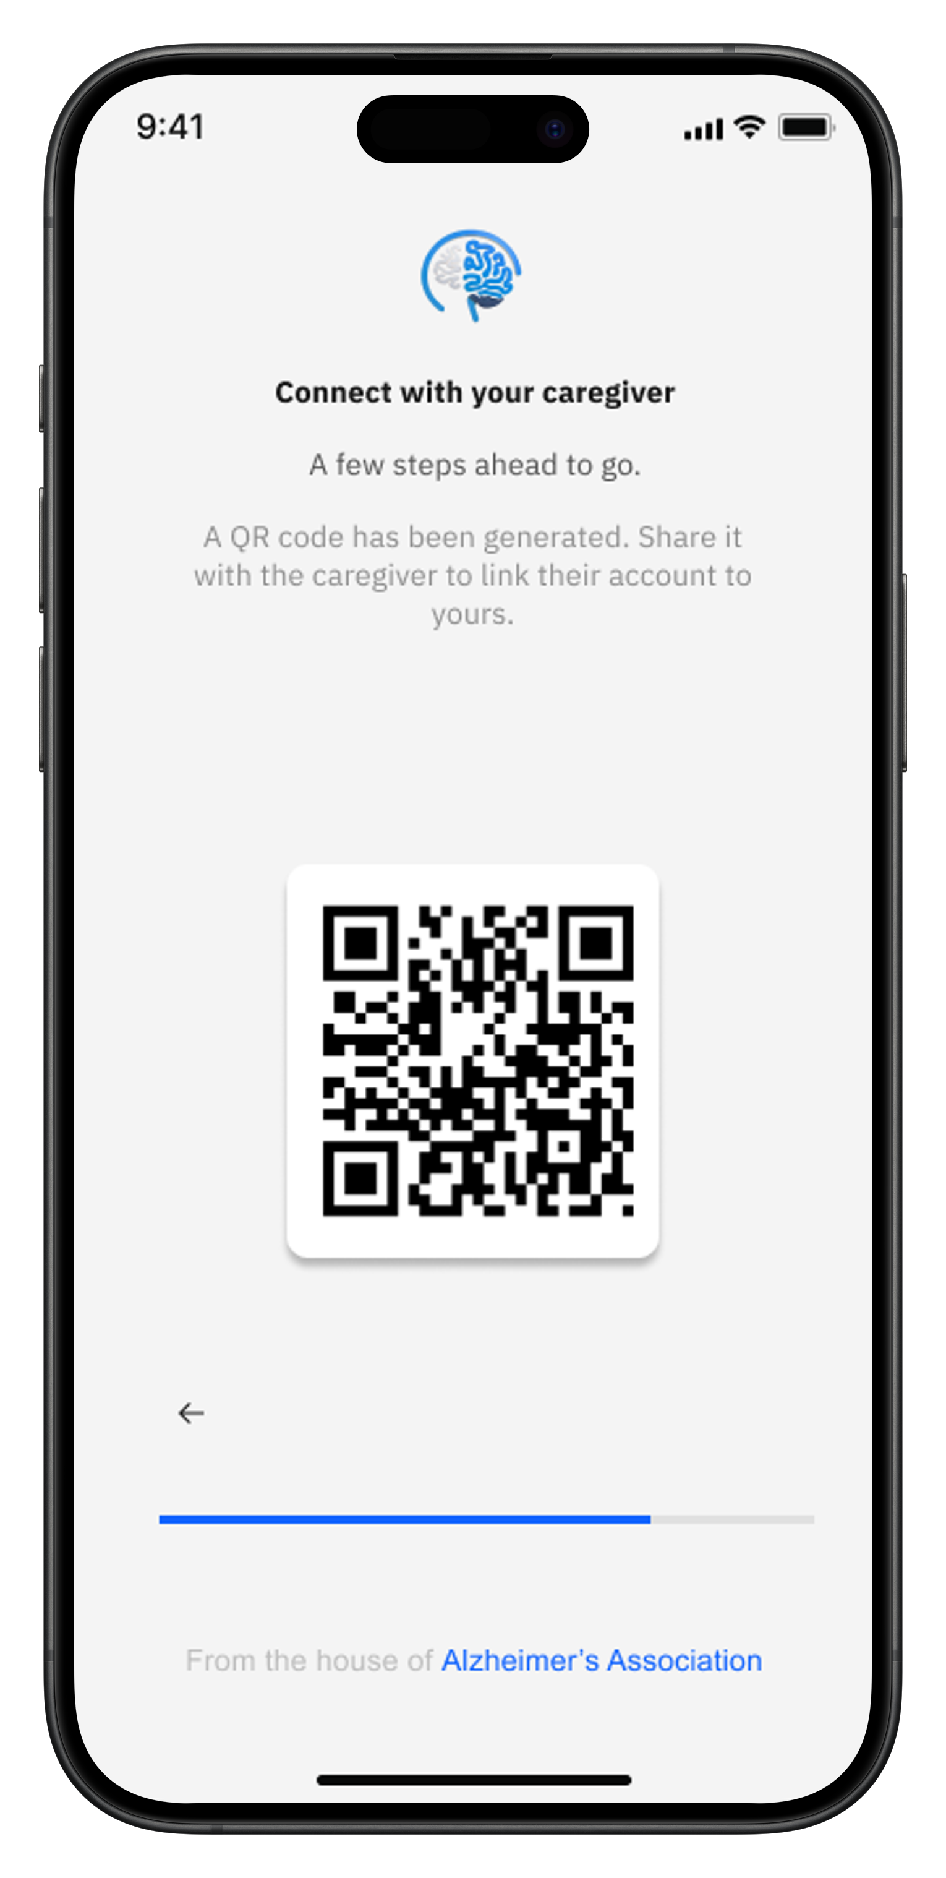
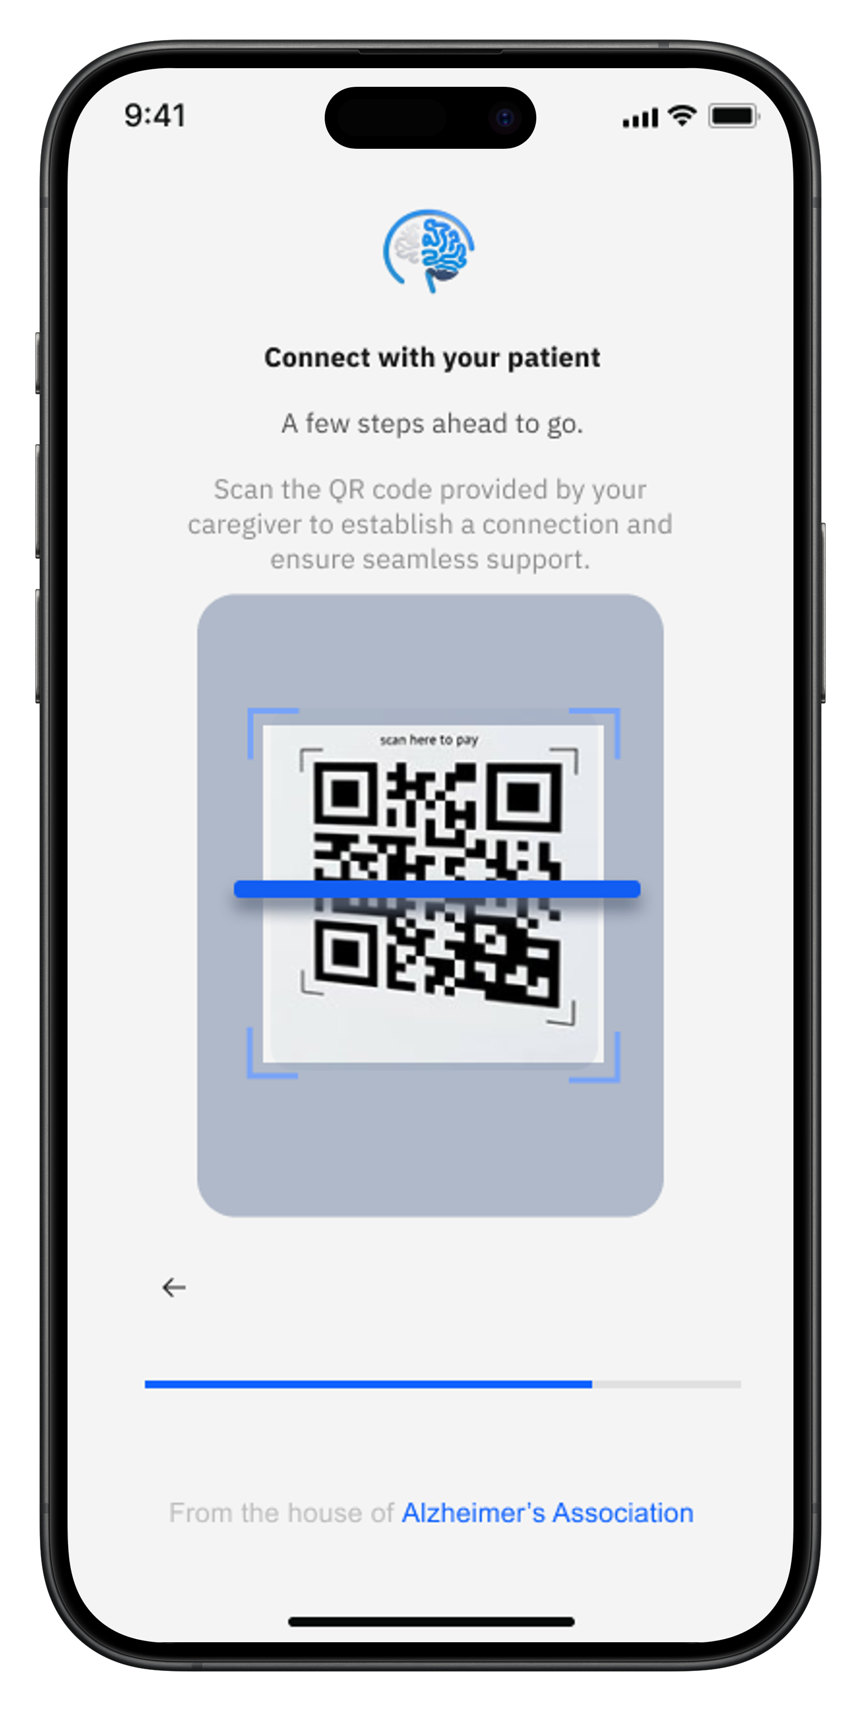
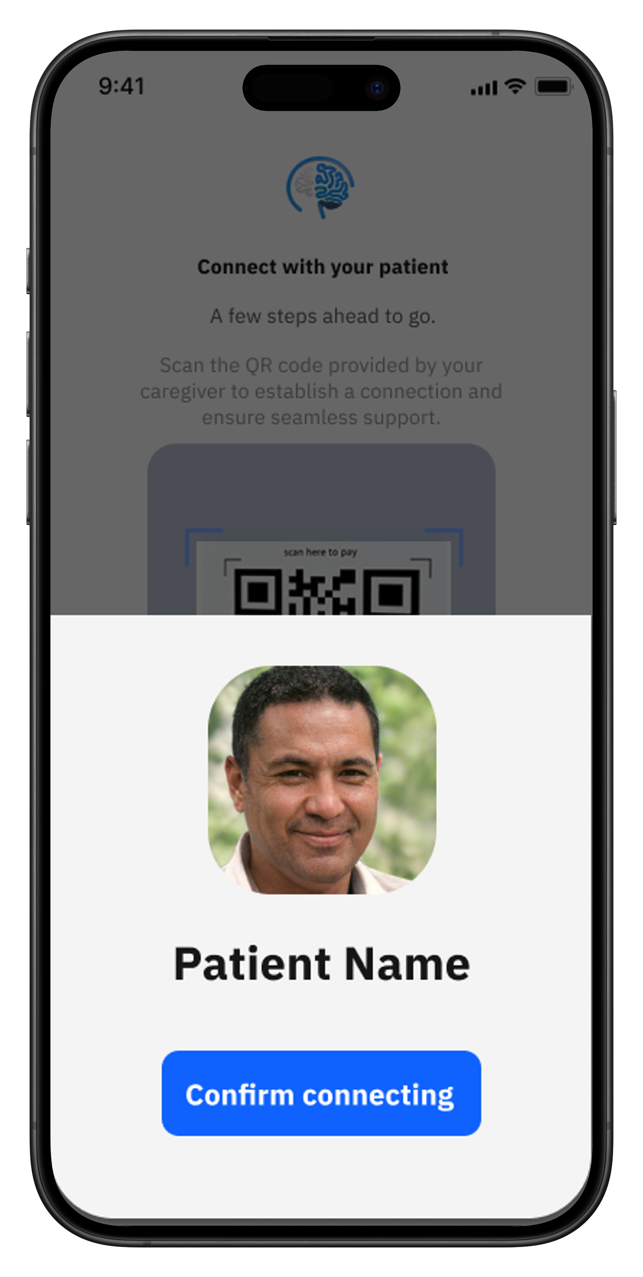
Linking Patient with caregiver
Patient App
Caregiver App
24

Slide 25
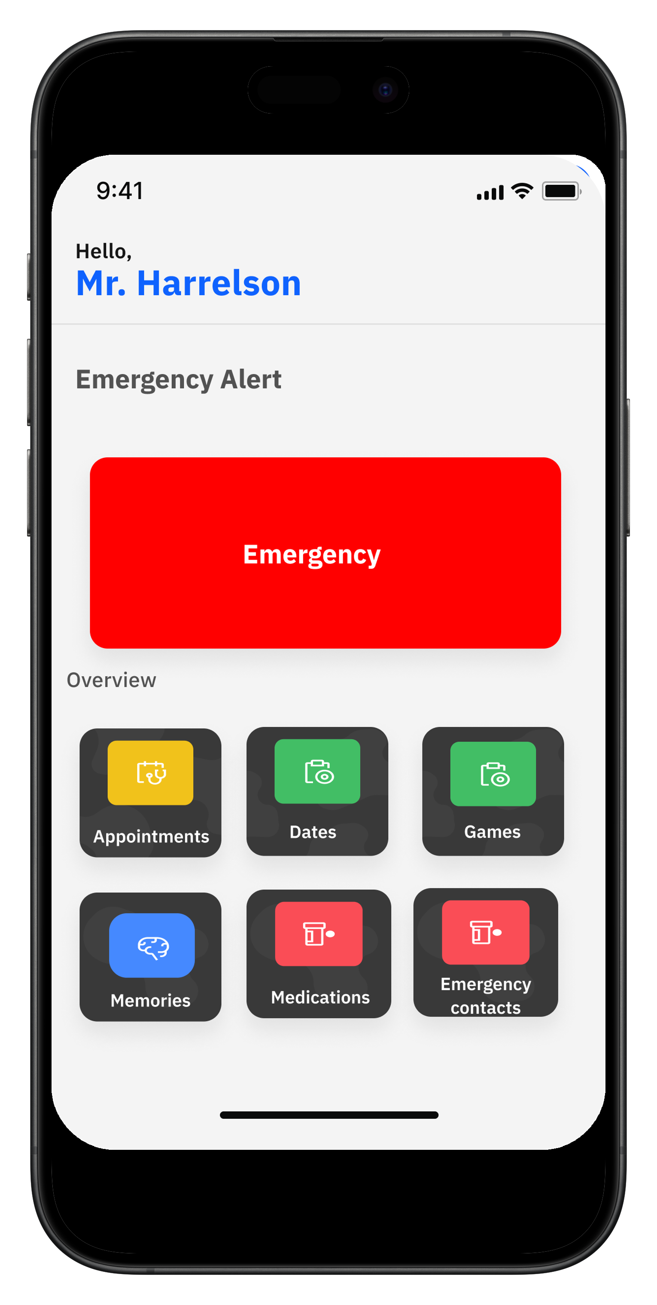
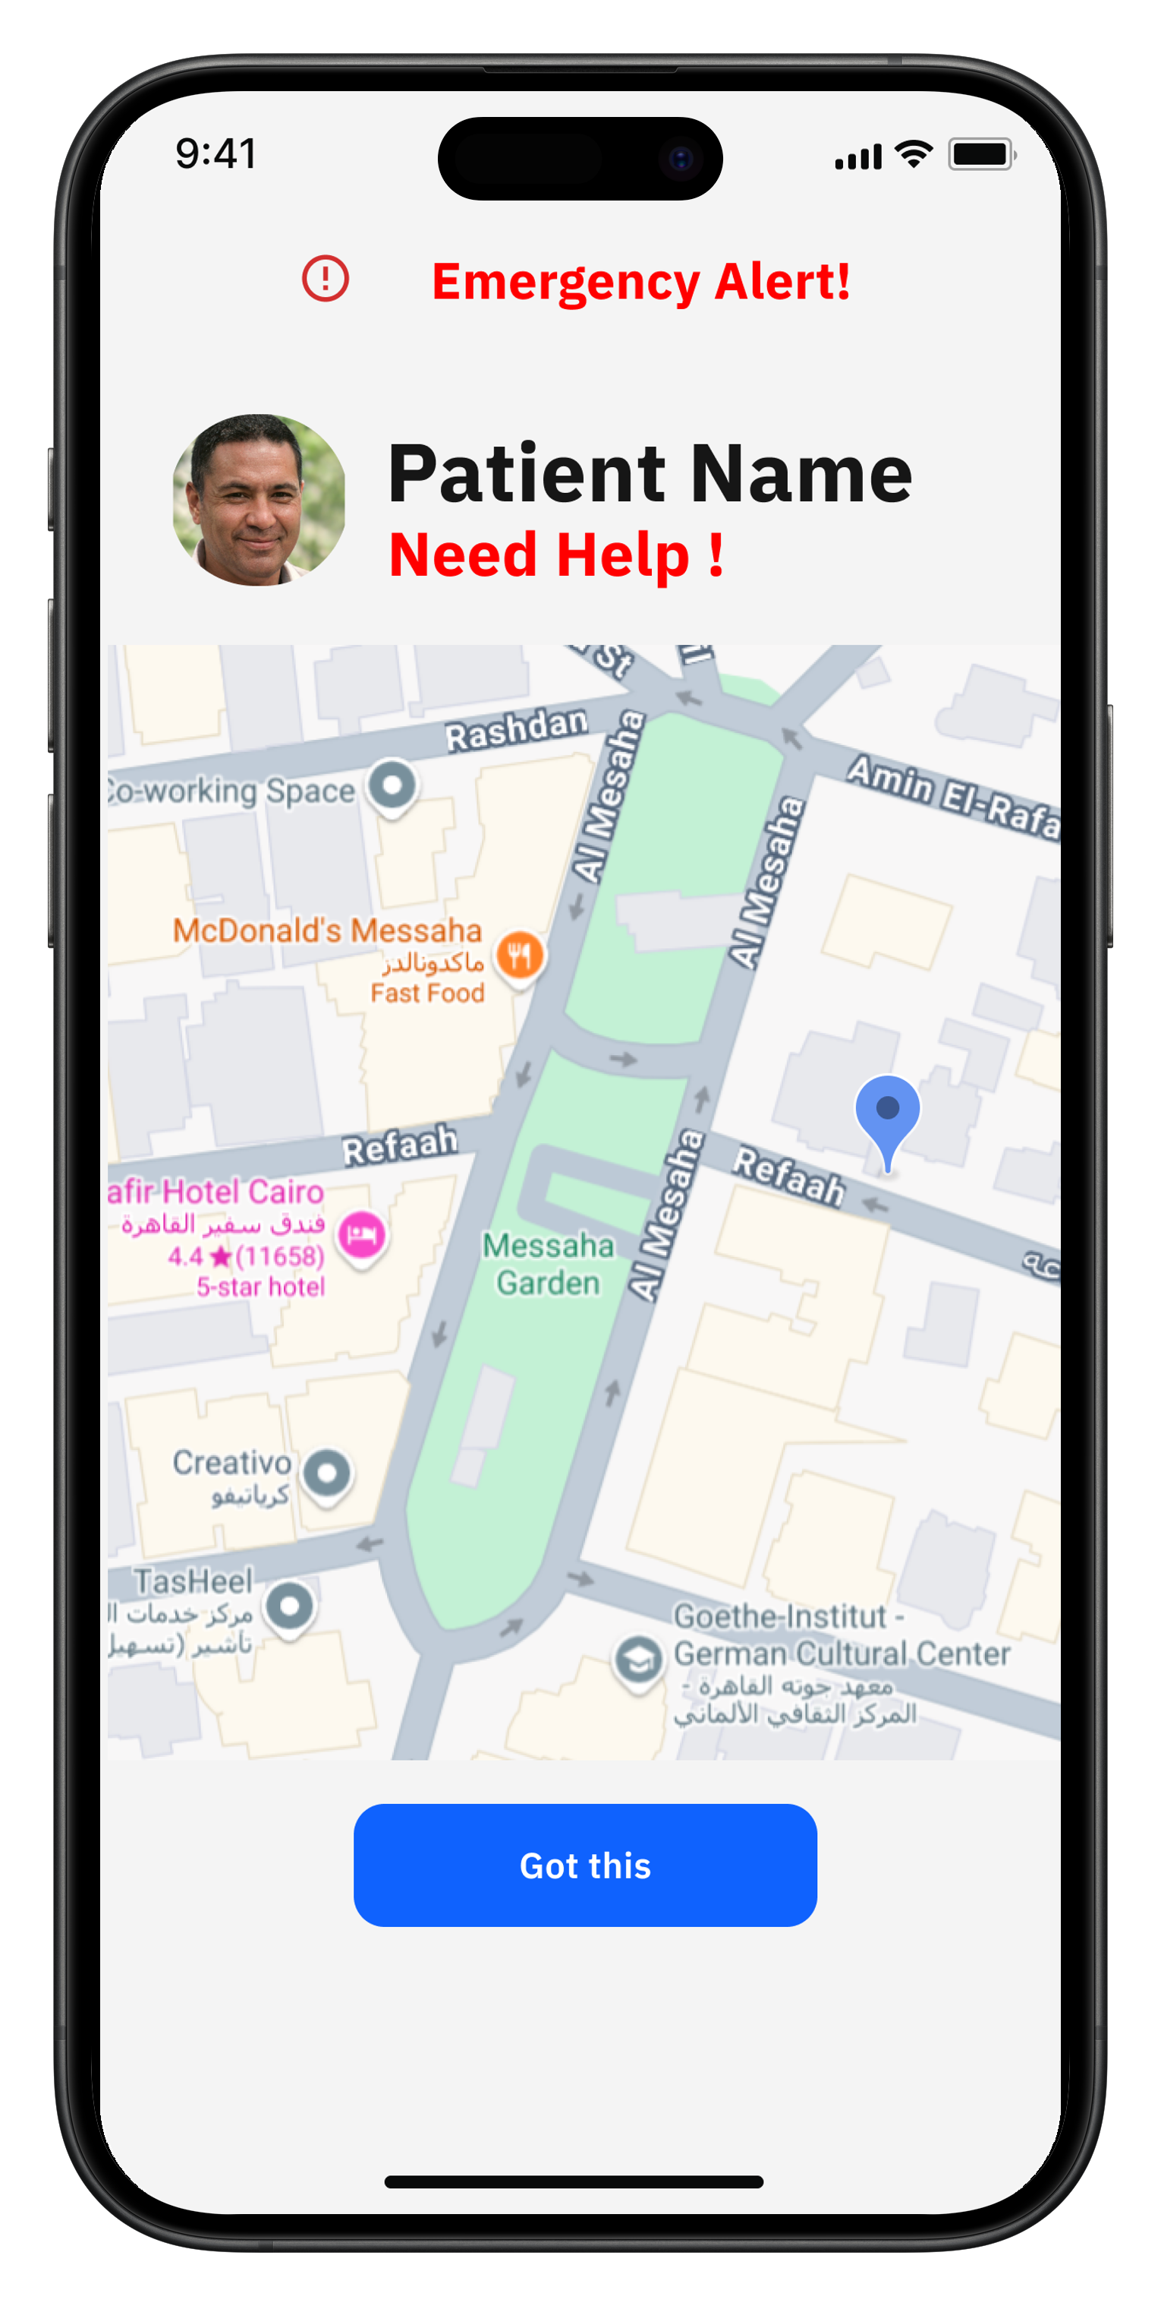
Emergency Request (SOS)
Patient App
Caregiver App
25

Slide 26
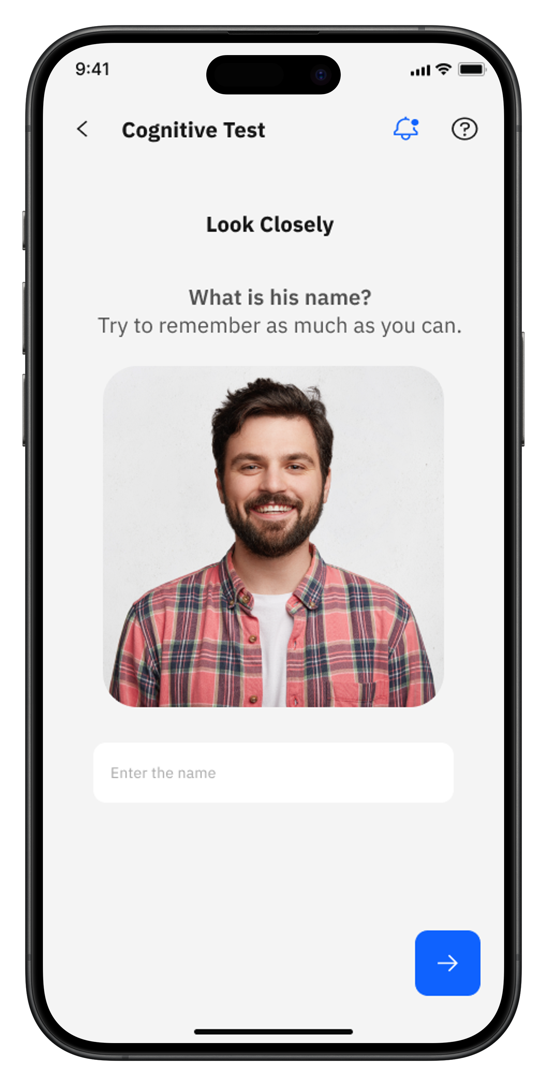

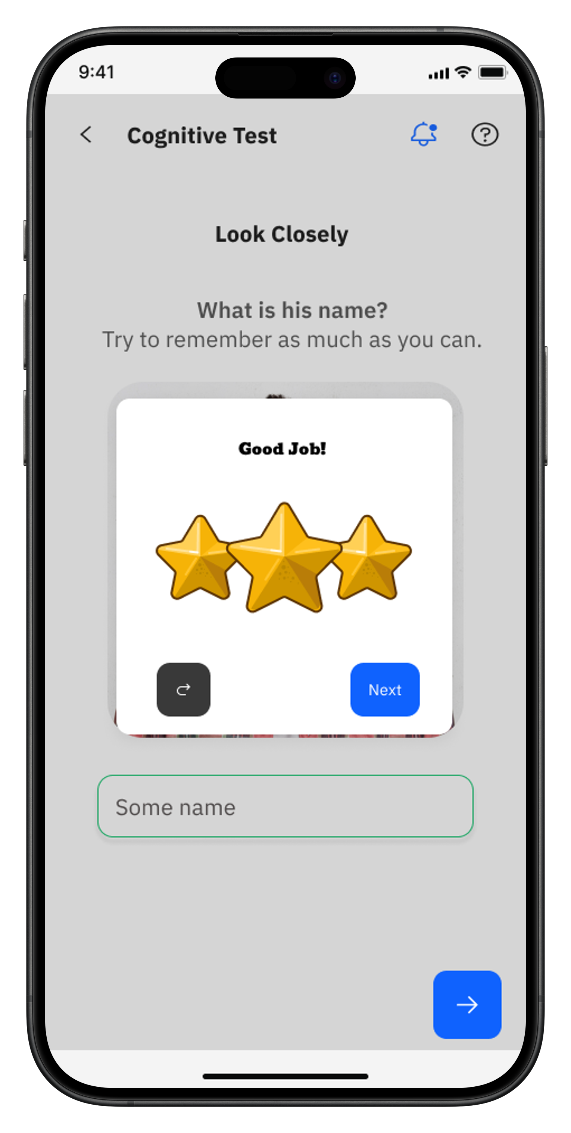
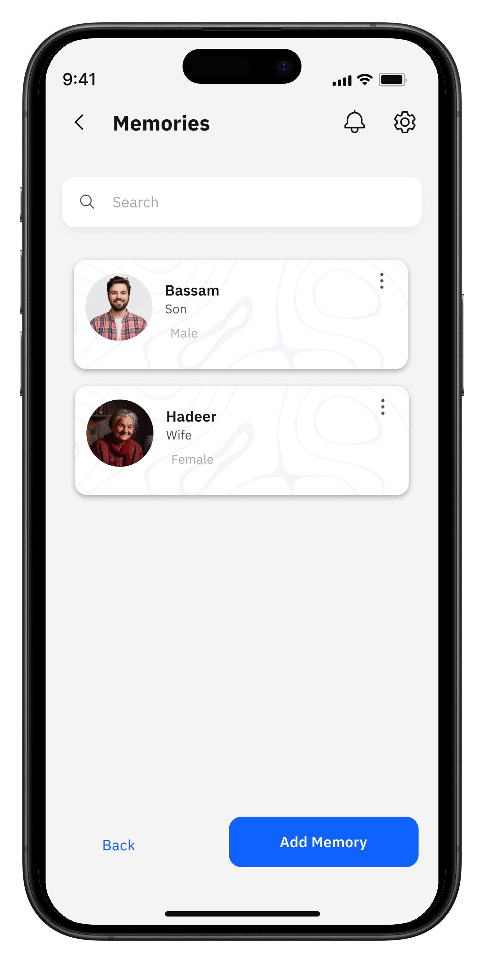
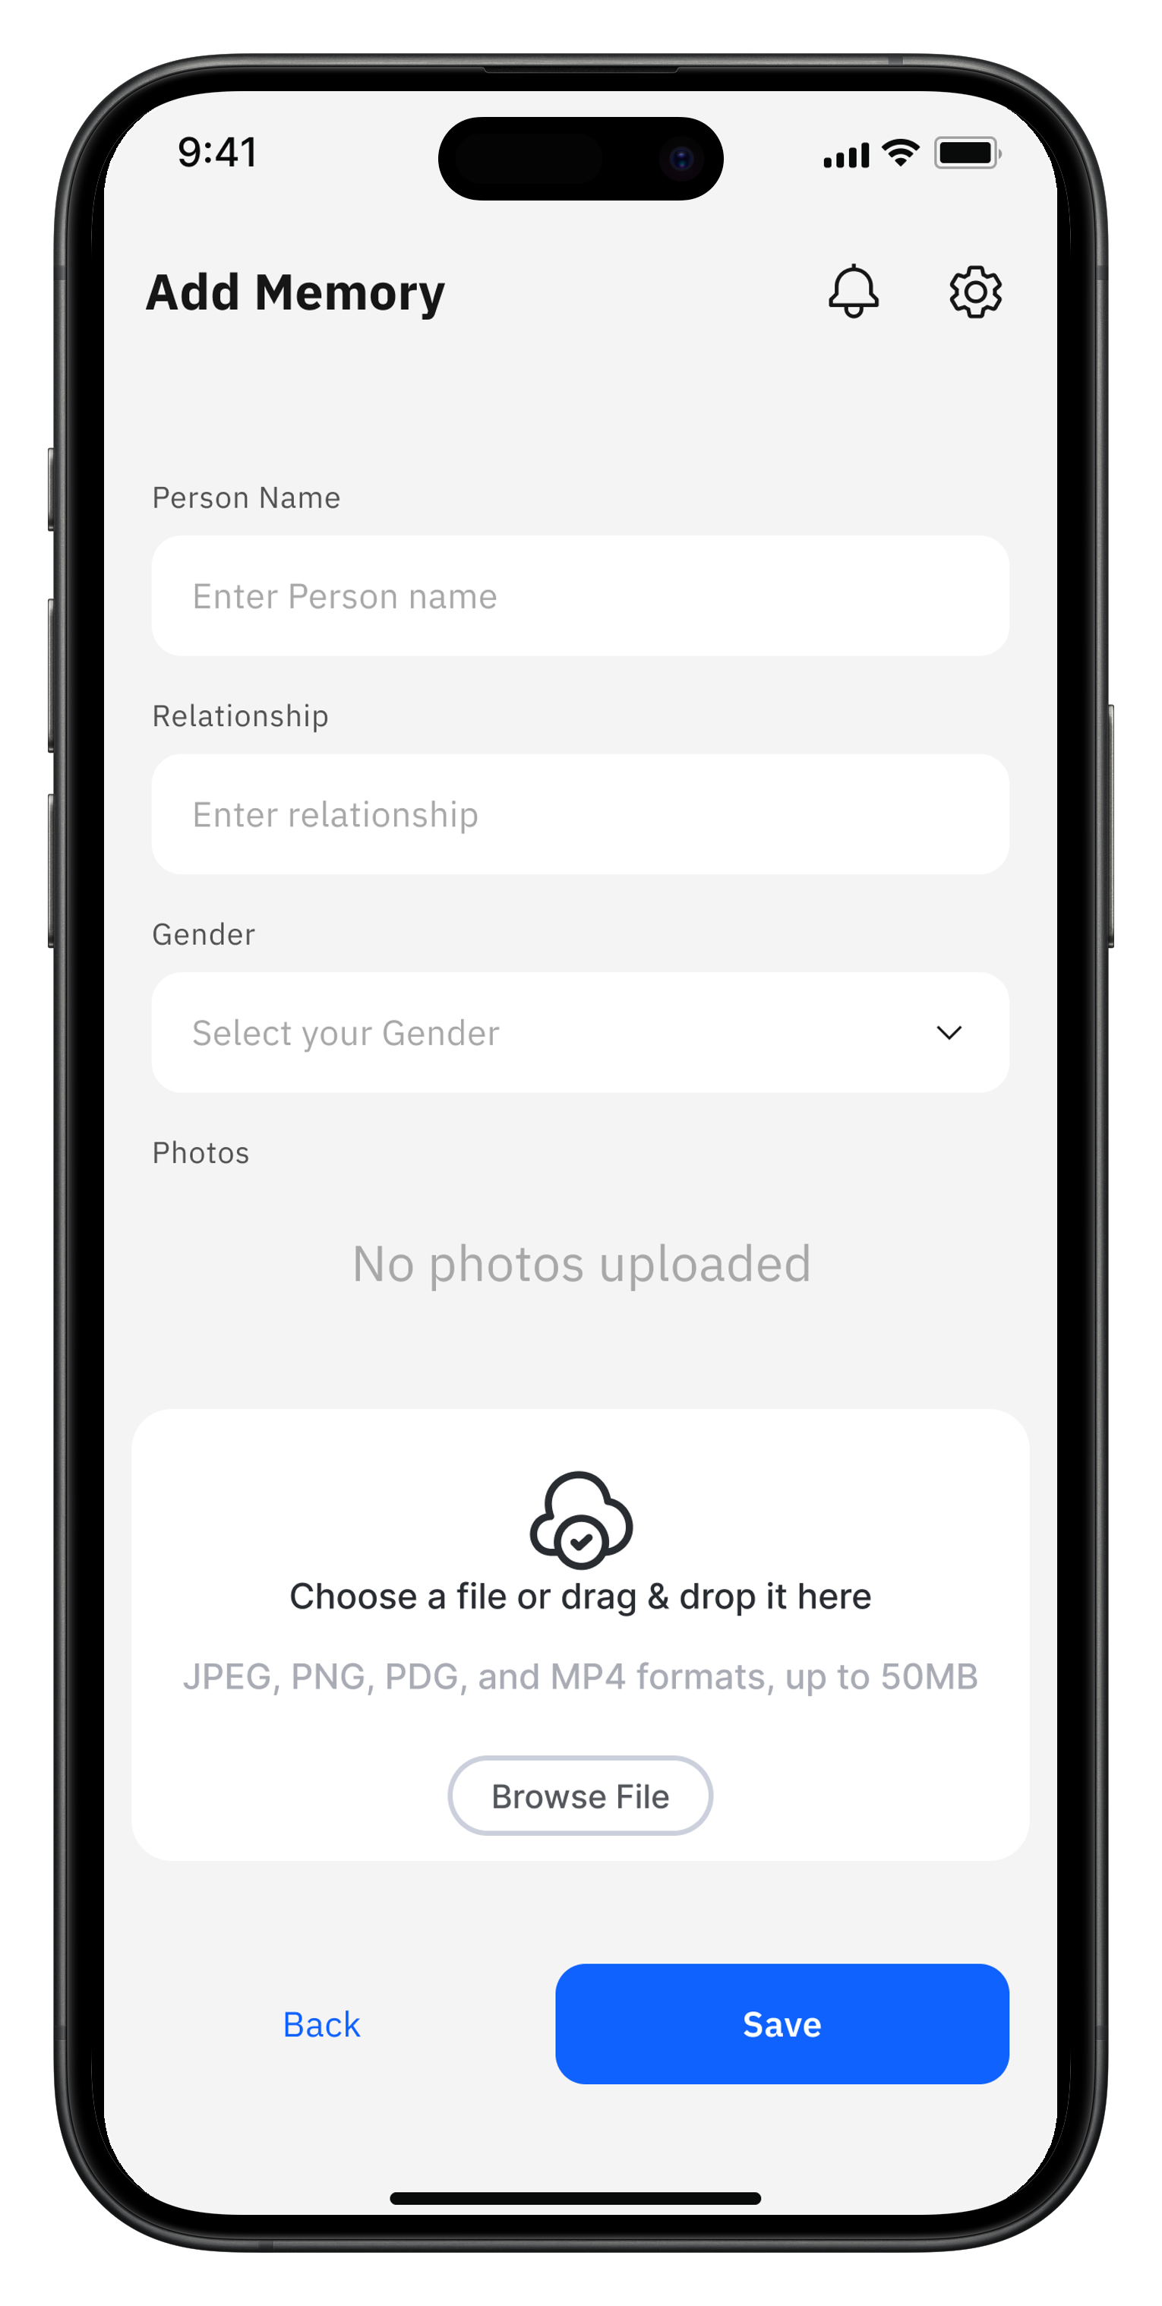
Memory Test
Patient App
Caregiver App
26

Slide 27
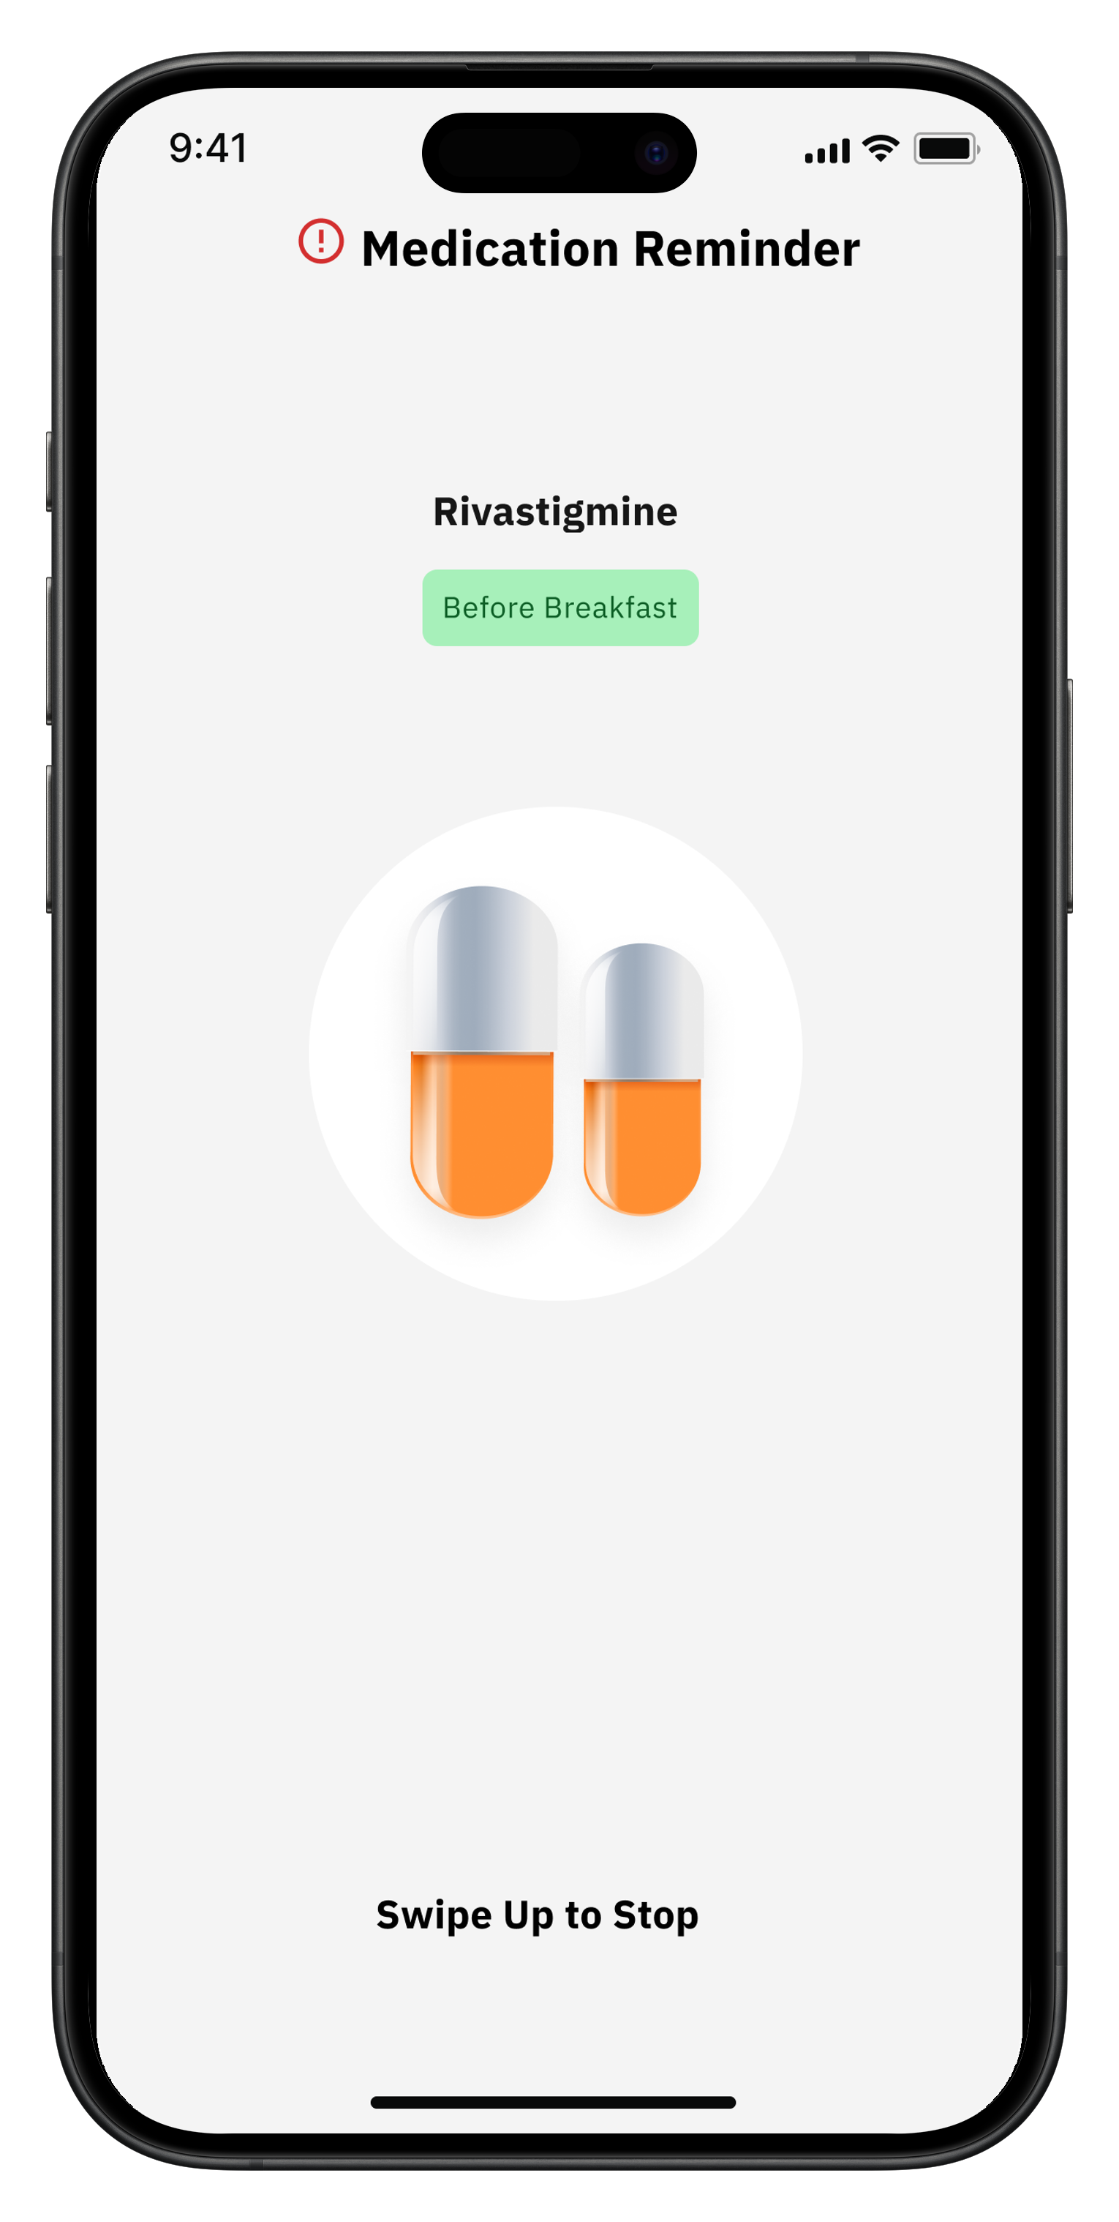
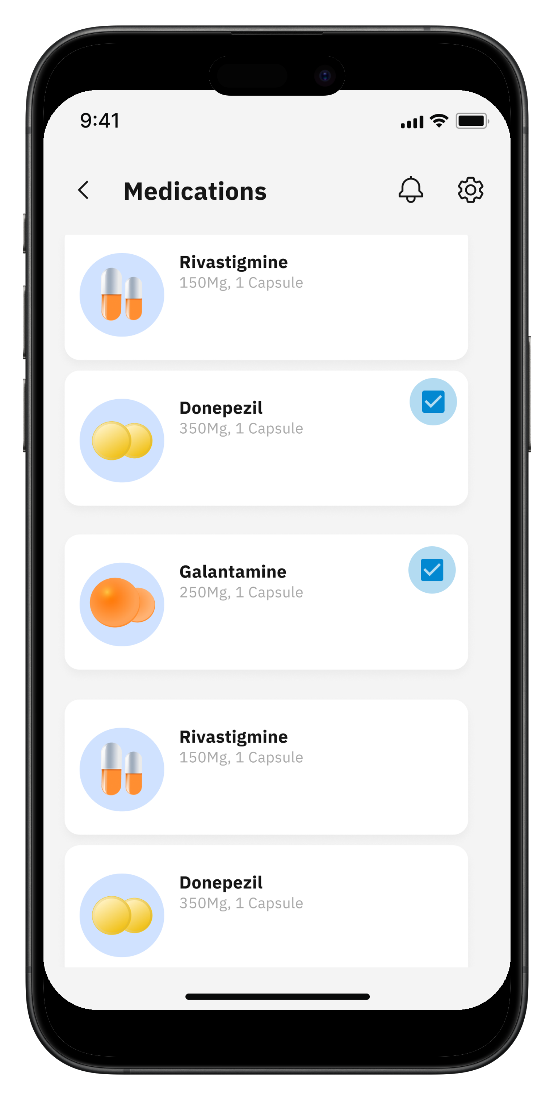
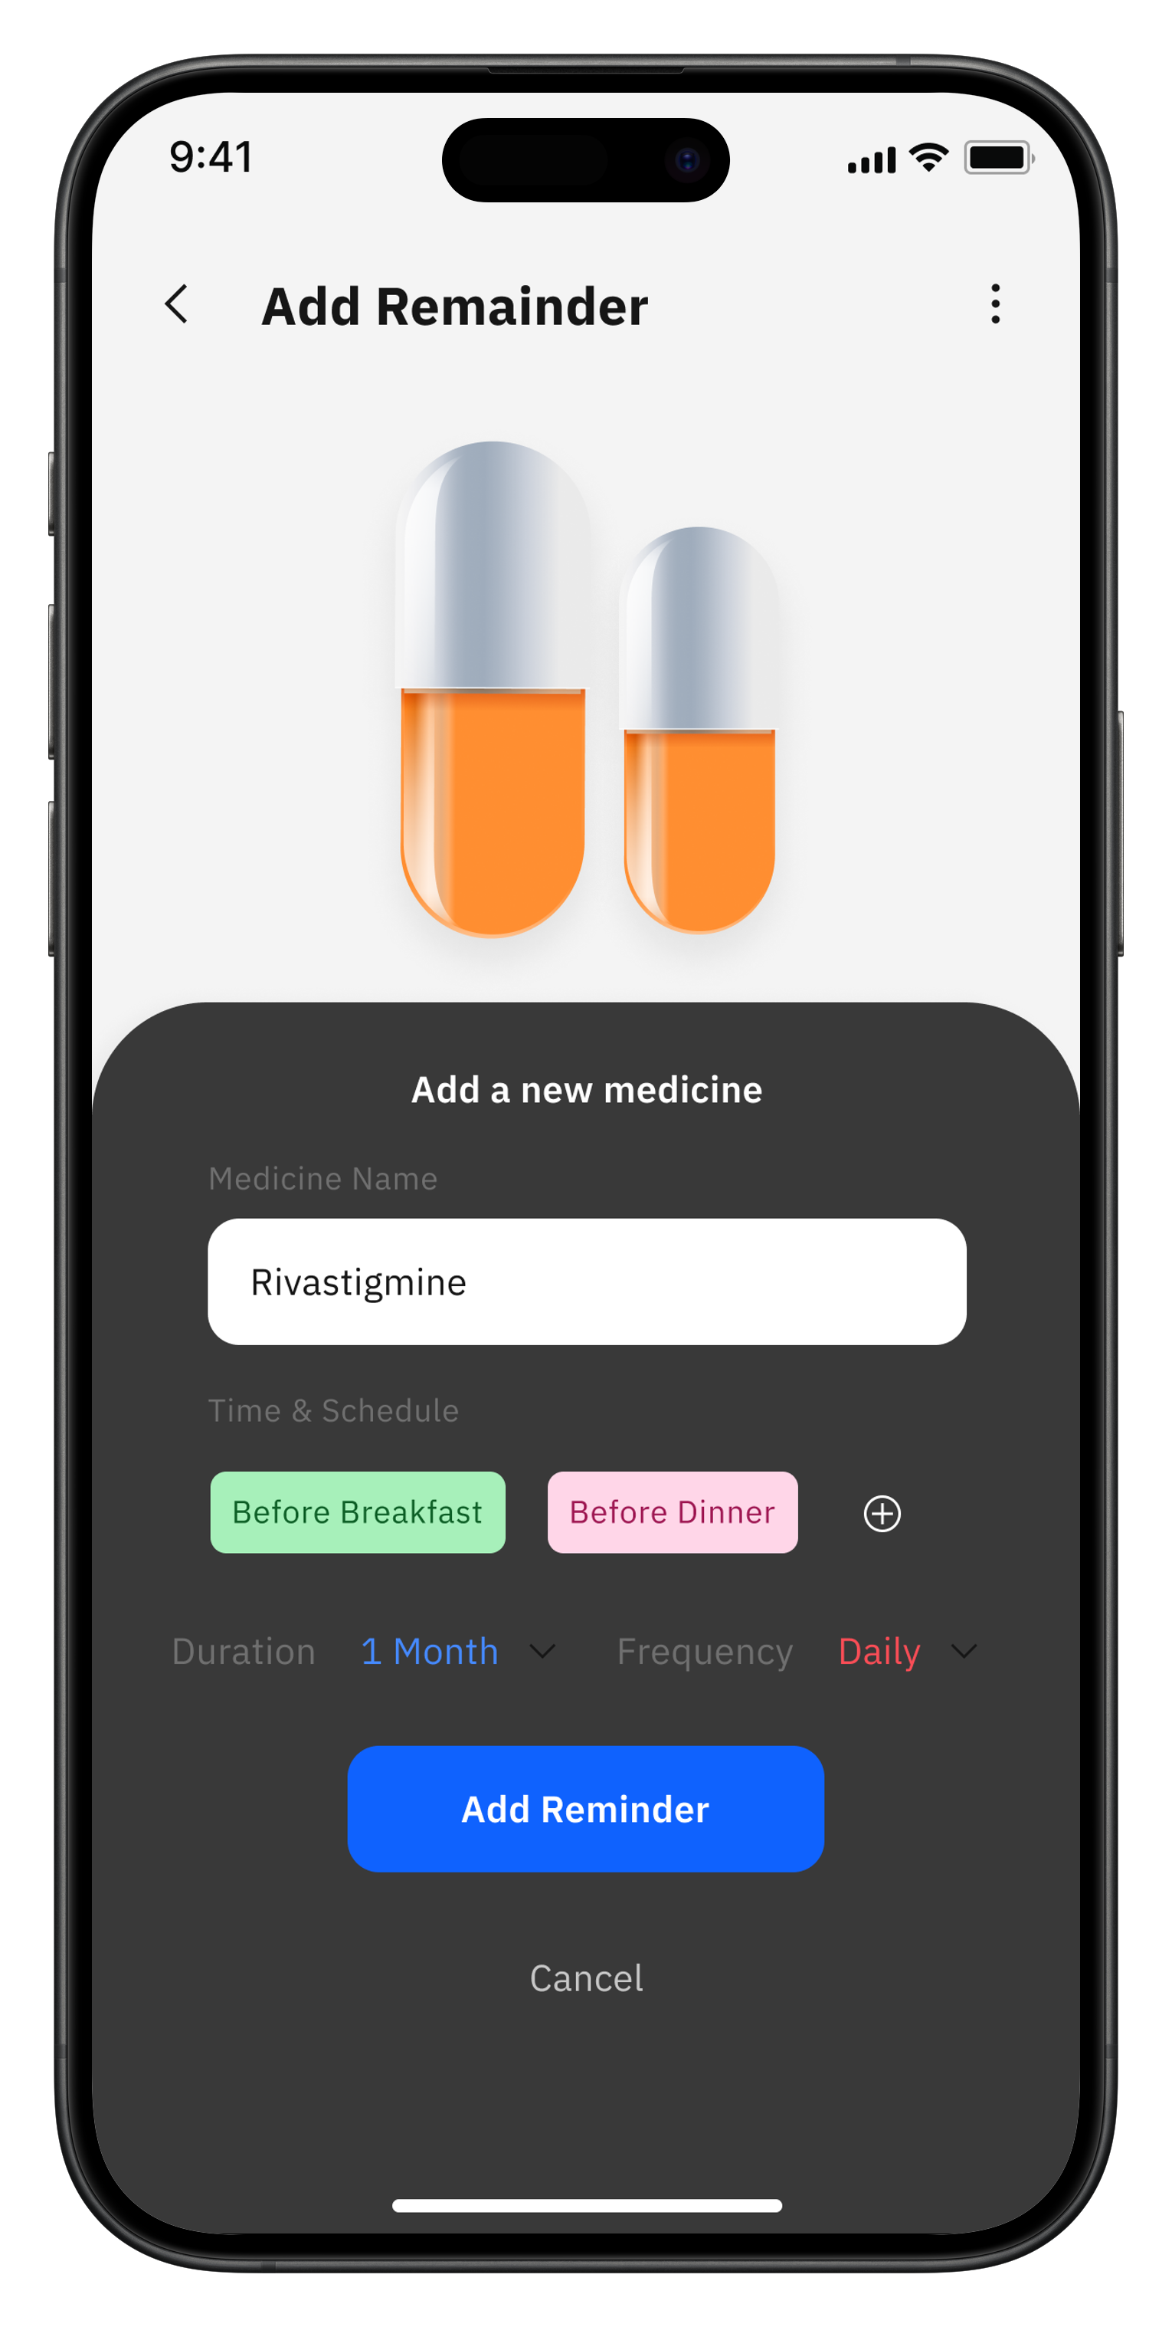
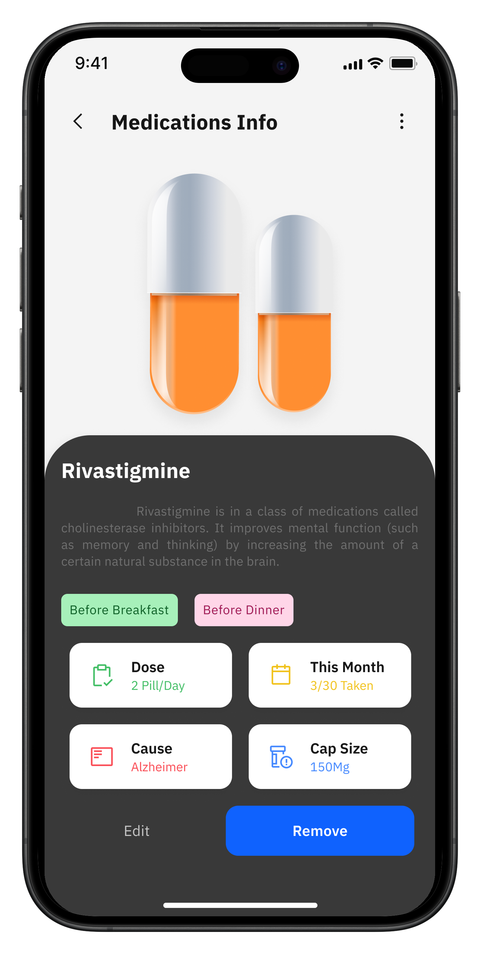
Medicine Reminder
Patient App
Caregiver App
27

Slide 28
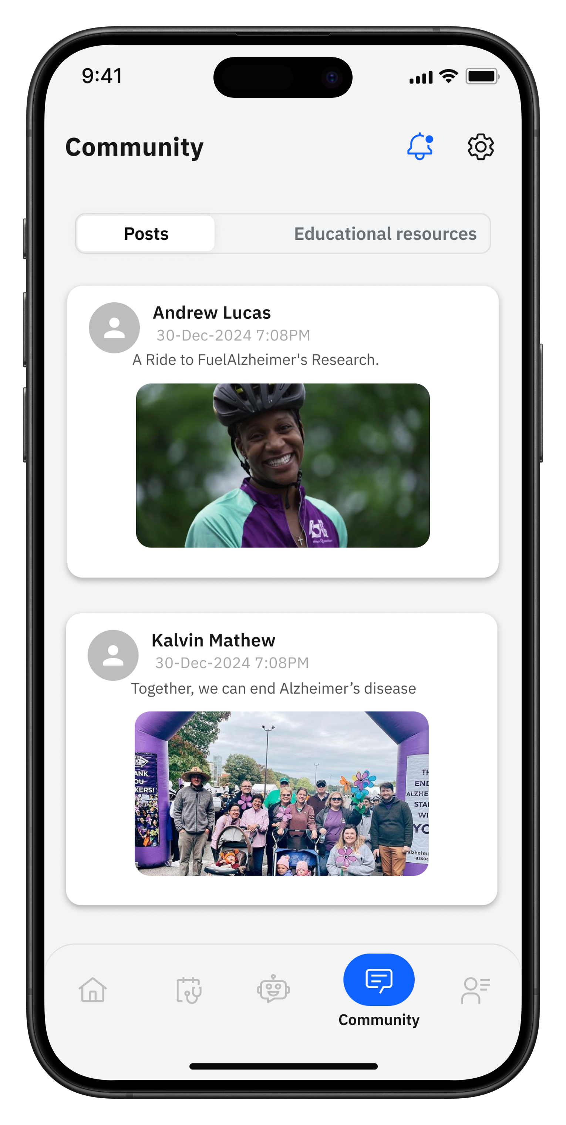
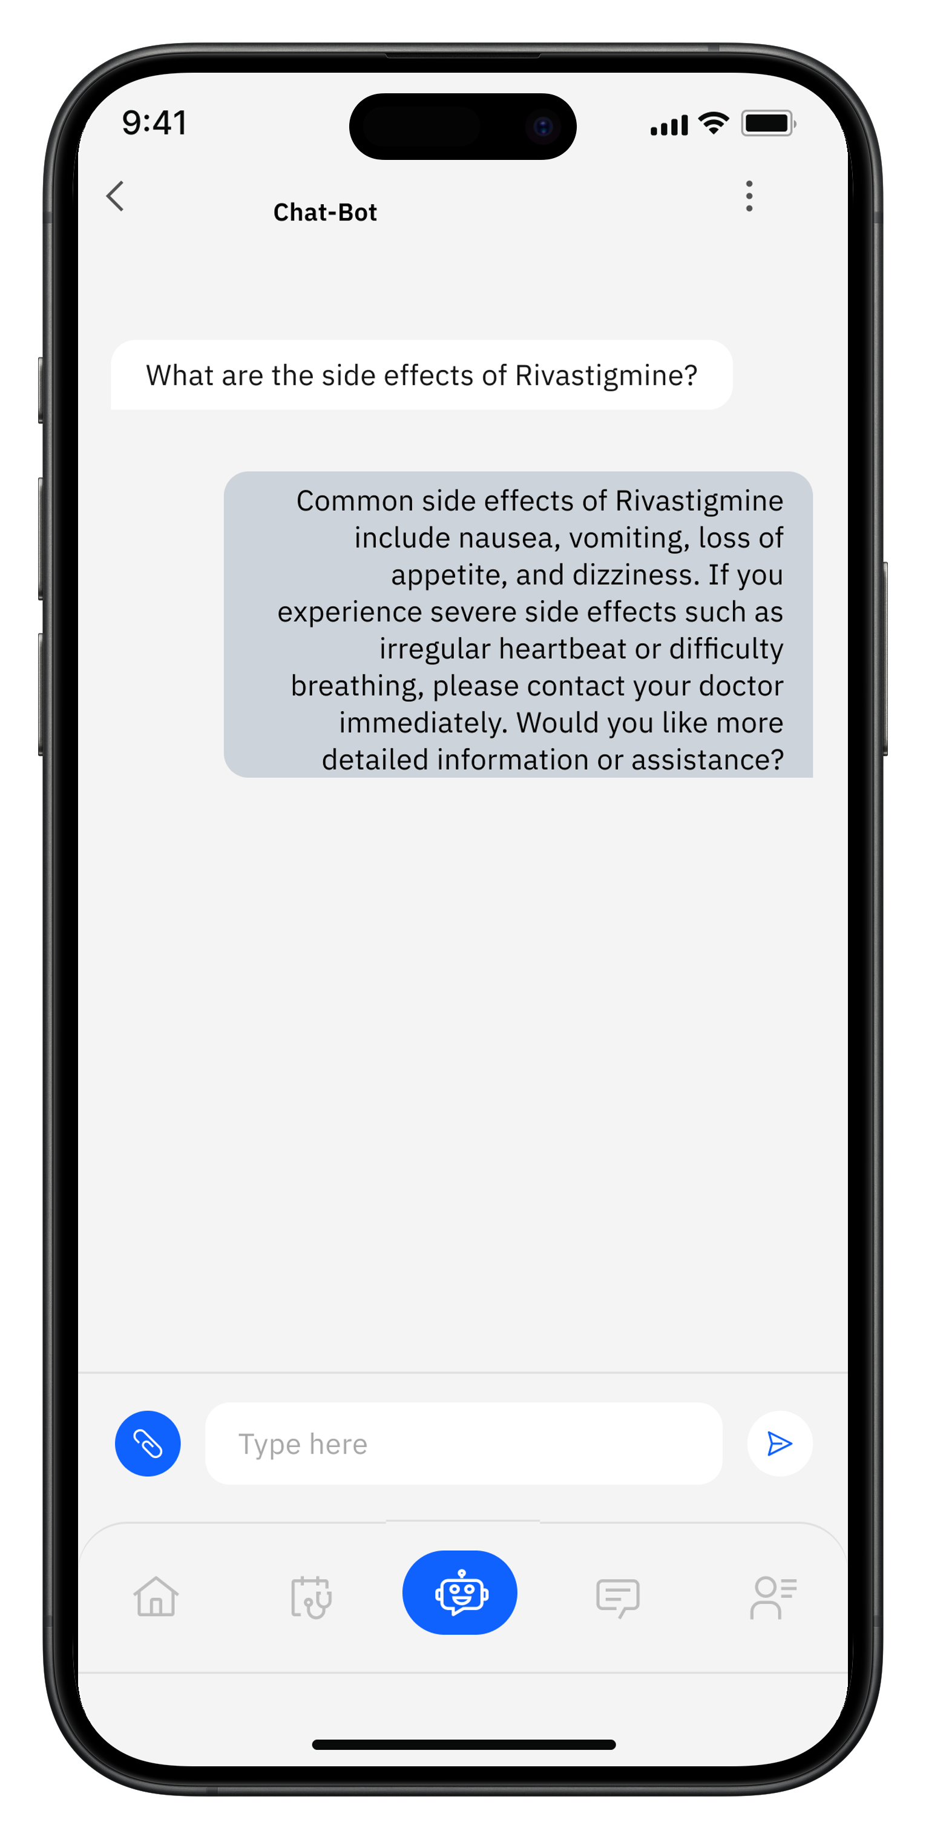
Community & AI Chatbot
Patient App
Caregiver App
28

Slide 29
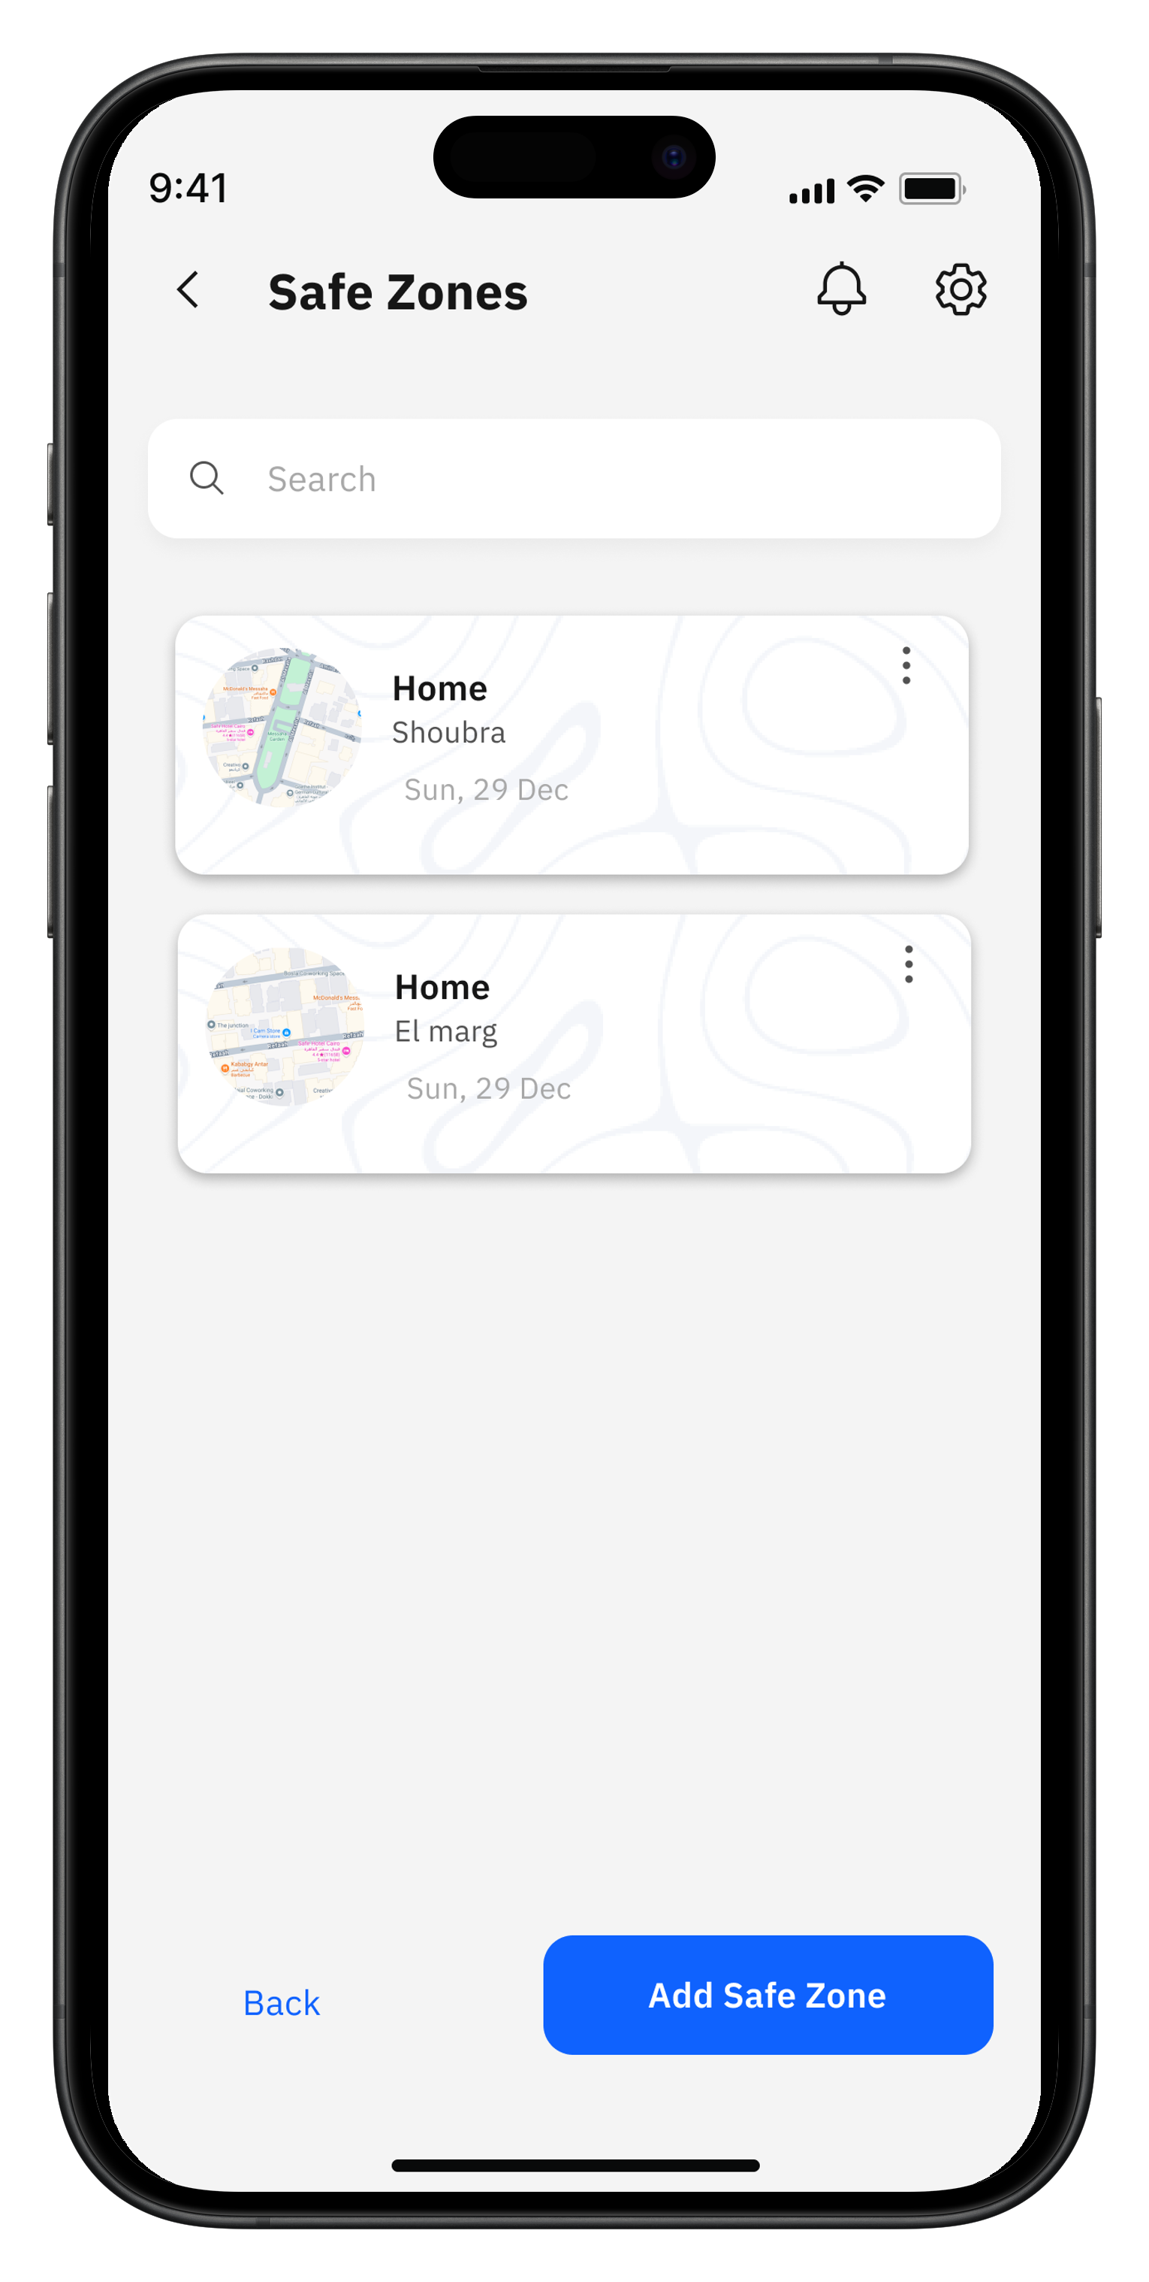
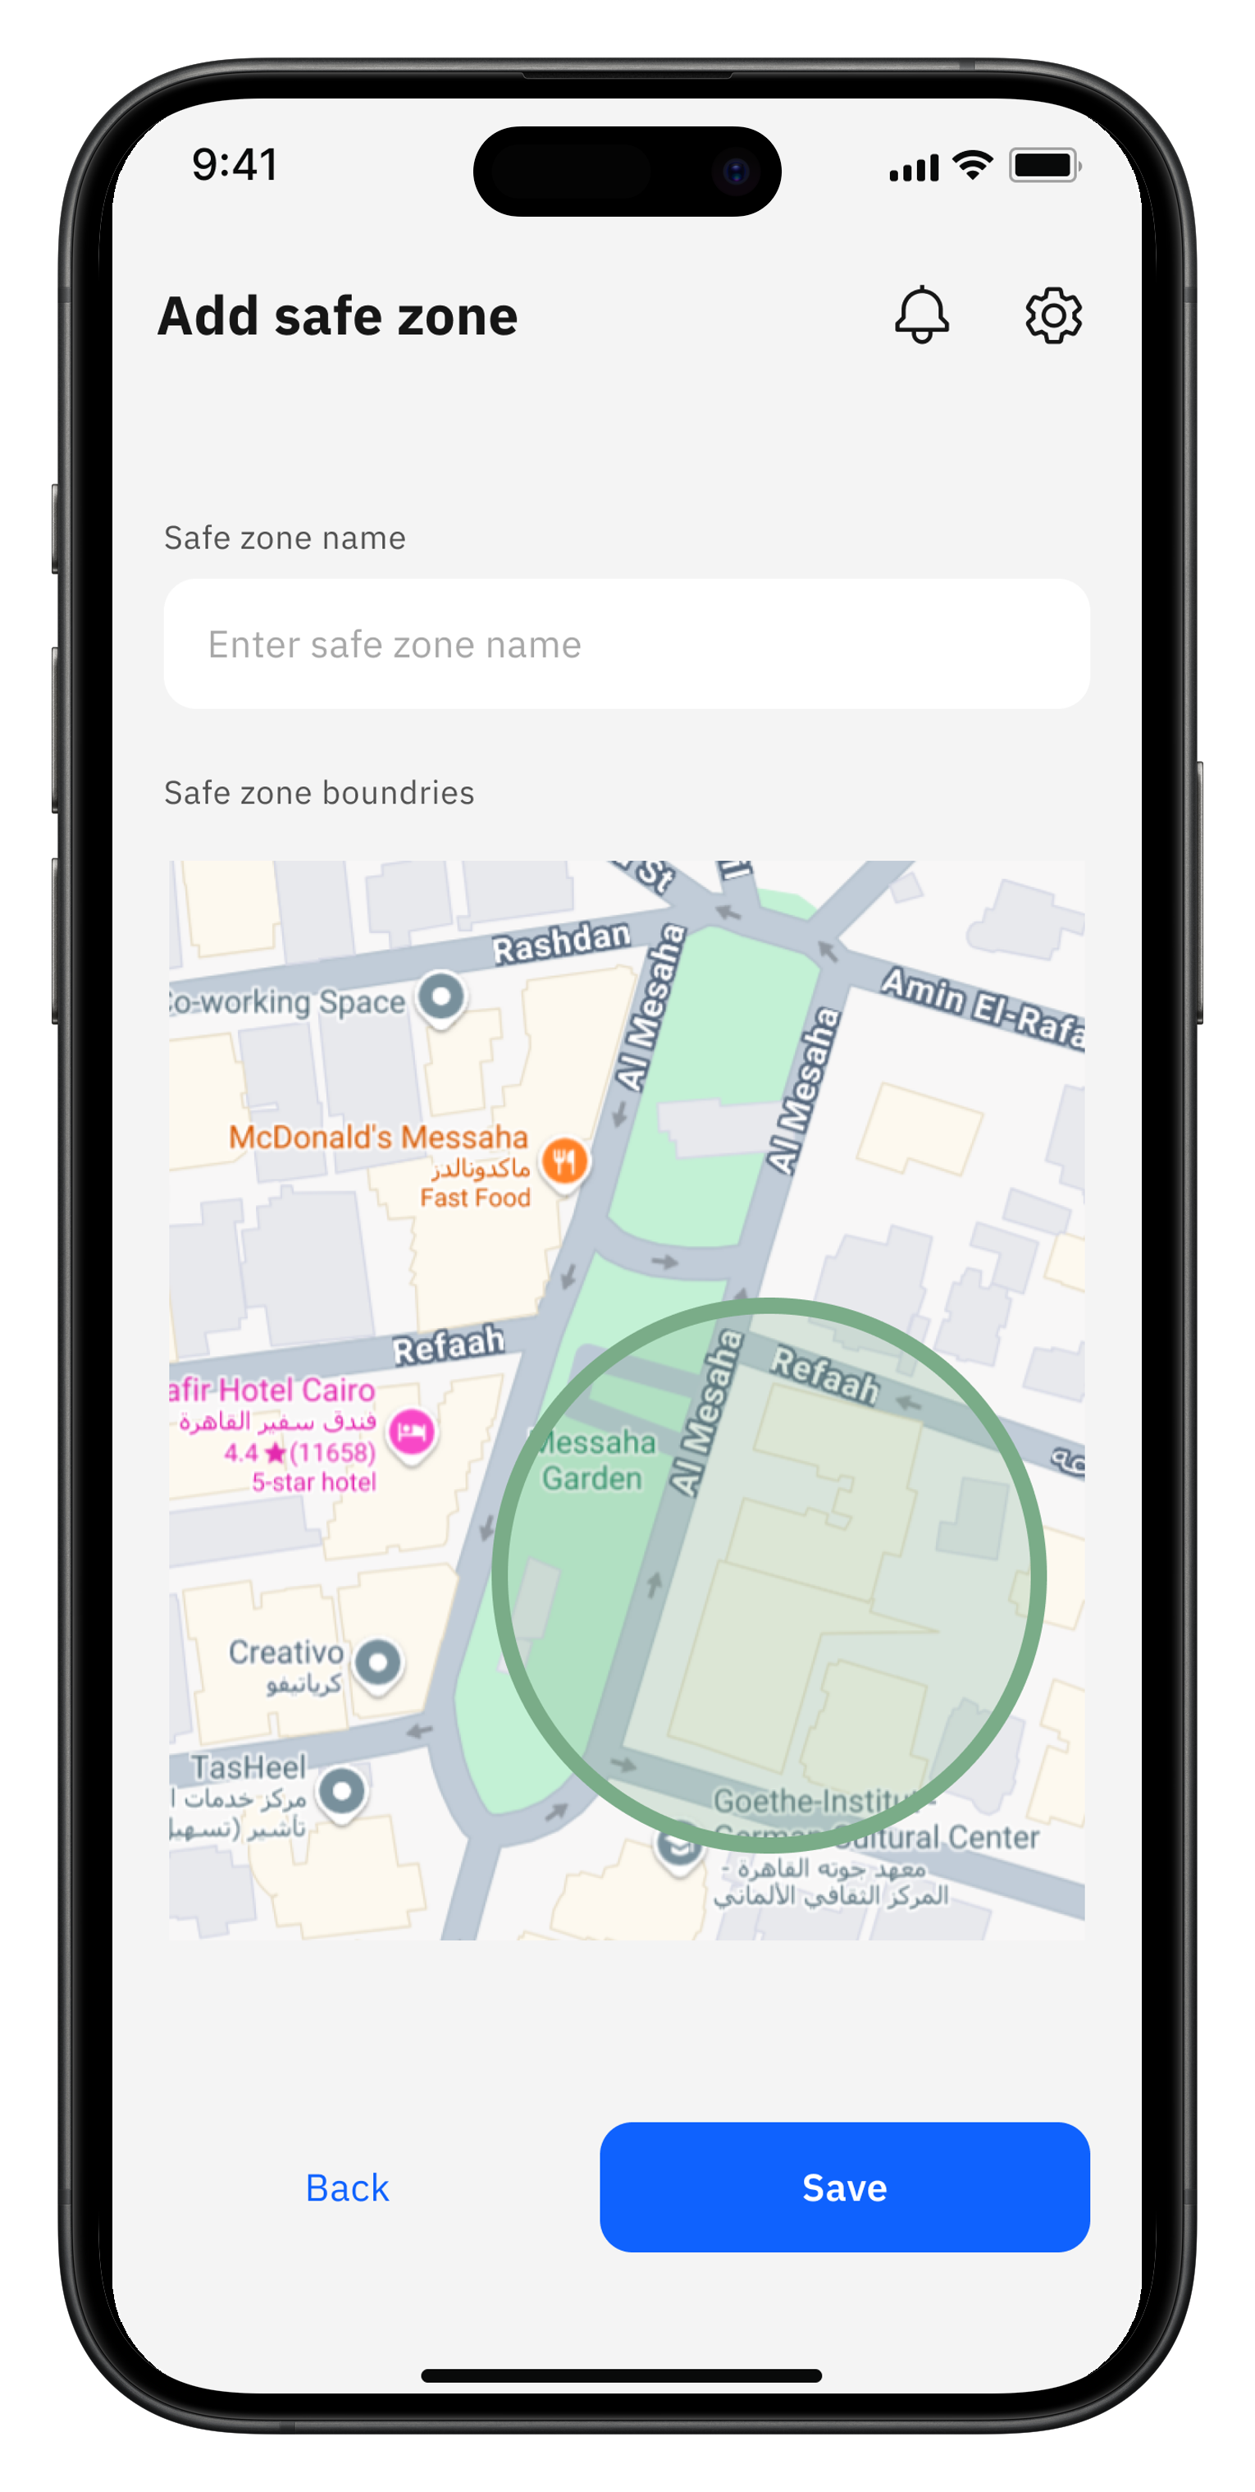
Safe Zones
Caregiver App
29

Slide 30
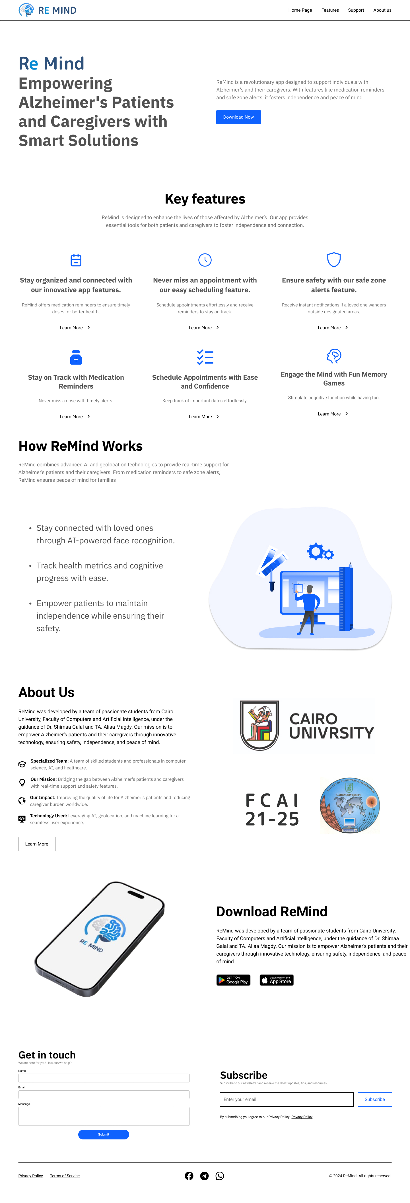
Landing website

Slide 32
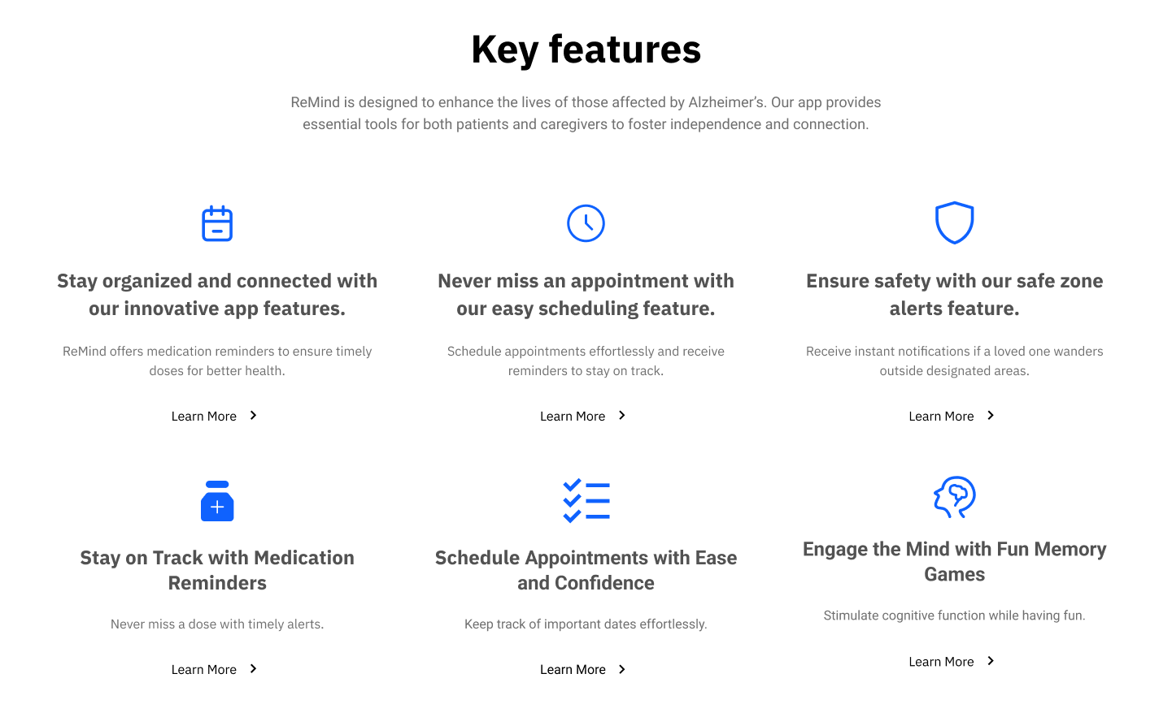
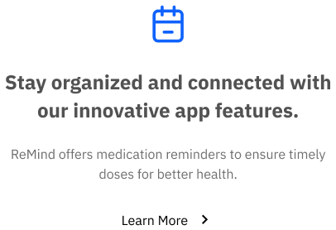
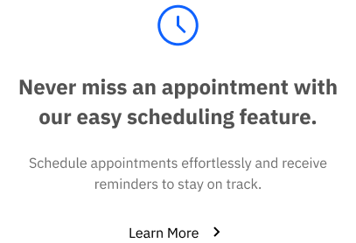
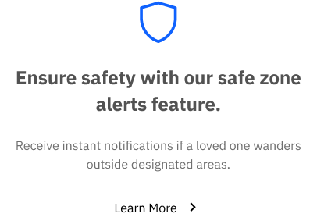
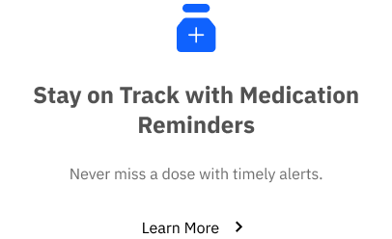
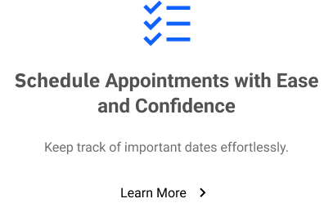
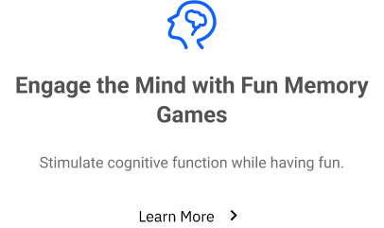

Slide 33
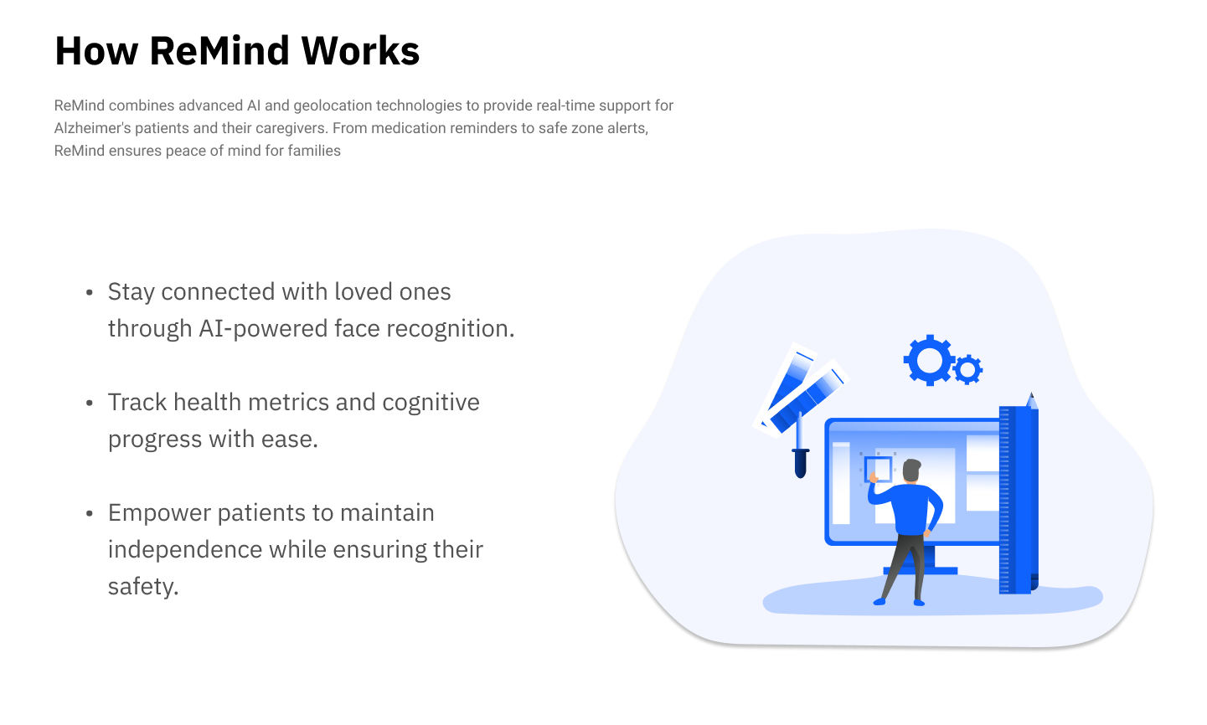

Slide 34


Slide 35
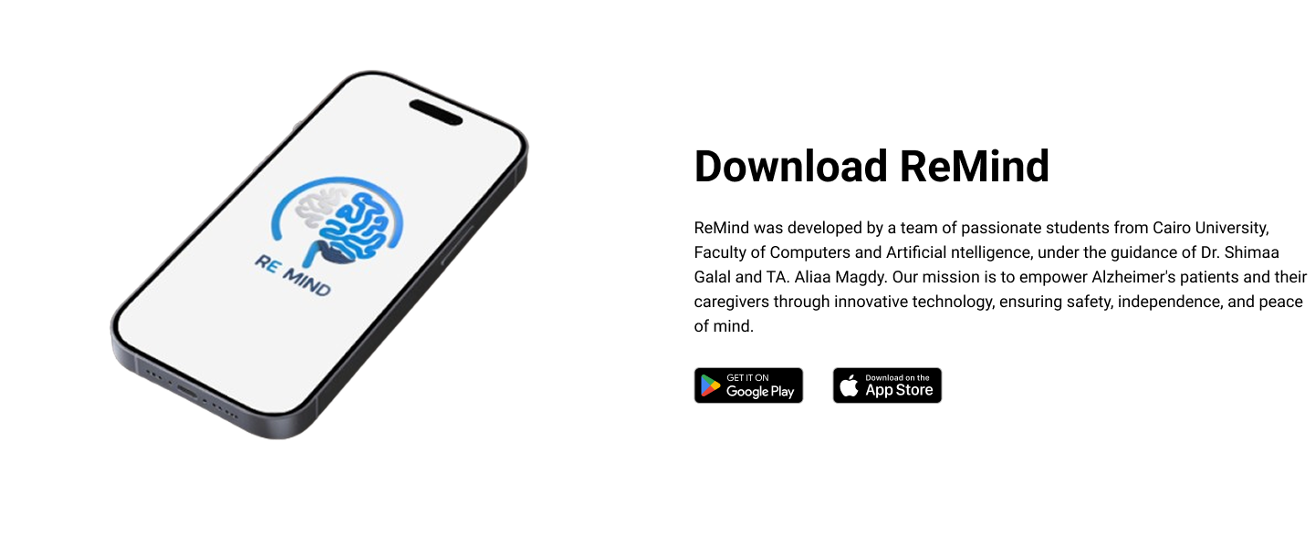

Slide 36
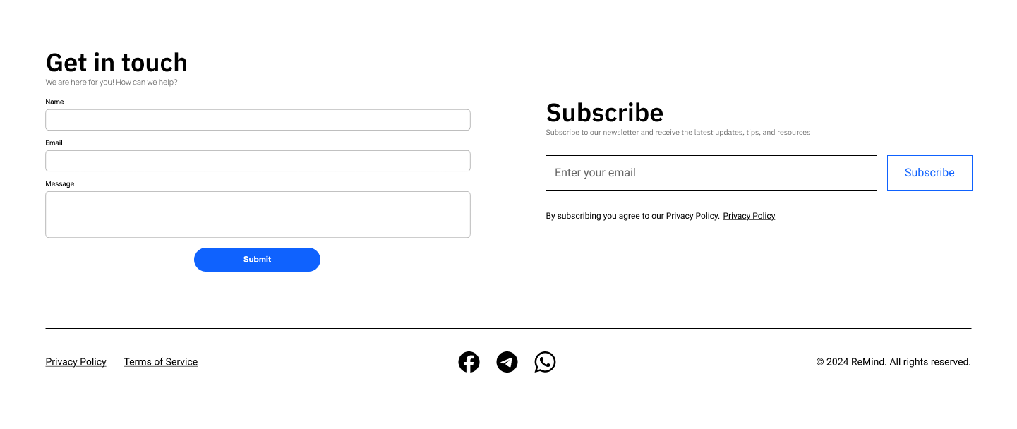
01
02
03
04
05
06
07
09

Slide 37
09
Technologies
01
02
03
04
05
06
07
36
08

Slide 38


09
Technologies
Flutter
Next.JS
Modern UI toolkit for building cross-platform applications from a single codebase.
It provides a rich set of pre-built widgets, fast performance, and a reactive framework for building dynamic user interfaces.
Popular React framework for building interactive user interfaces.
It promotes the use of reusable components and server-side rendering for efficient performance and seamless experience.
Frontend
37

Slide 39


09
Technologies Cont.
Express.JS
Flask
Express.js is a server-side JavaScript framework designed for building scalable and fast web applications.
It is used in this project to handle real-time operations, such as
sending notifications and managing user sessions.
Flask is a lightweight Python web framework ideal for creating robust back-end services and APIs.
It is used in this project to handle operations with the model and
AI-based requests.
Backend
38

Slide 40


09
Technologies Cont.
MongoDB
MySQL
NoSQL database designed for scalability and flexibility
Used to store real-time location data efficiently.
Allows fast retrieval and updates.
Relational database known for reliability and consistency.
Manages structured data with data integrity.
Supports complex queries and relationships.
Database
39

Slide 41



09
Technologies Cont.
Git
GitHub
It enables developers to:
Track changes to the codebase.
Revert to earlier versions when needed
GitHub is cloud-based hosting services for git repositories.
It provides remote collaboration feature
Version Control
40

Slide 42
27

